Slide 1
Program Executive Officer (PEO) Review and Outlook (R&O)
24 March 2016
Brig Gen Michael Schmidt

Slide 2
ISR & SOF Description and Mission
Det 1,661 AESS/
Denver
WII
Creech
OL-DET3
WPAFB
WIV
Philadelphia
OL
645AESS
Tinker
OC-ALC
WIV
Patuxent River
DET
WII
Gray Butte
OL-DET3
645 AESS
Greenville
DET2
WIV
Cherry Point
OL
WII
San Diego
Poway
DET3
WIU
Kirtland AFB
Robins AFB
WIU
Kadena AB, Japan
WIU
Redstone Arsenal
WIU
Hurlburt Field FL
661 AESS
Waco
WIU
Corpus Christi
WII
Amendola AB, Italy
A&AS:
23%
ACAT I - 4+1*
ACAT II - 4
ACAT III - 34
TENCAP - 17
FMS - 64
AML Exempt - 17
Big Safari - 34
NTNF - 2
* HC/MC-130 Recap
AFPEO ISR & SOF Mission: Equip Our ISR & SOF Warfighters to Dominate the
Battlespace
UNCLASSIFIED
Cleared for Public Release
88ABW-2015-2181

Slide 3
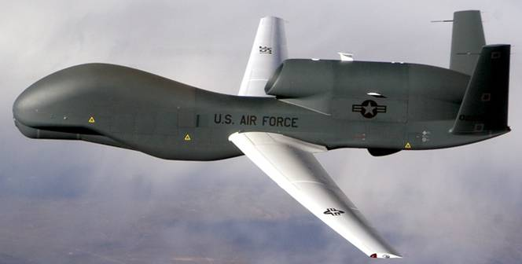
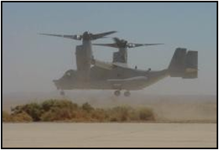
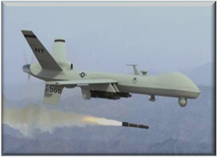
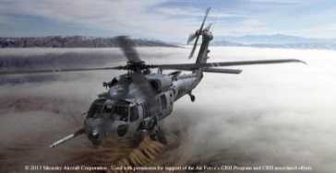
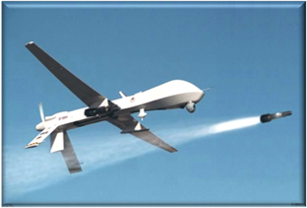
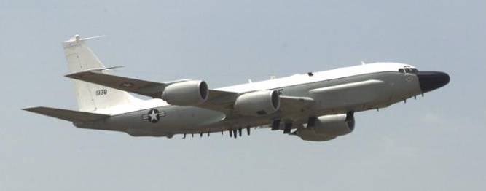
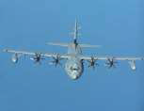
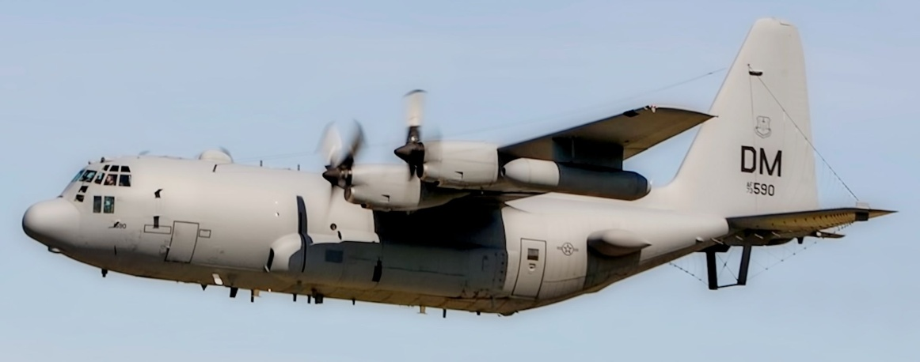
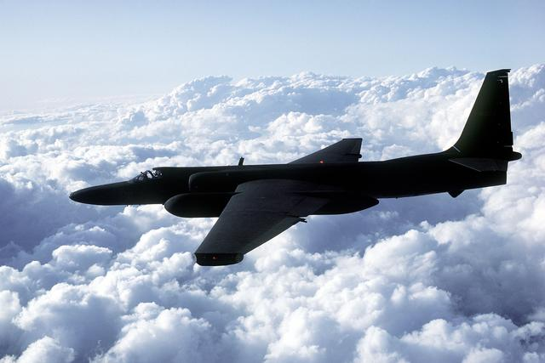
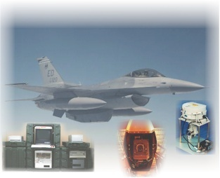
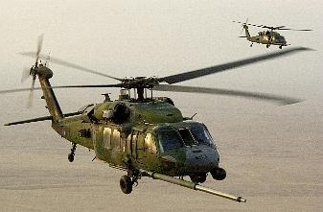
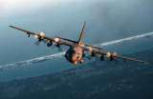
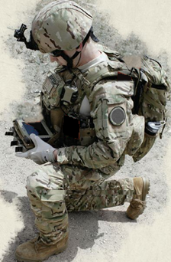
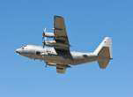
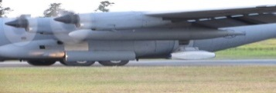
ISR & SOF Portfolio Overview
ISR – FIND/FIX
MOBILITY - INFILTRATE
STRIKE - FINISH
GLOBAL HAWK (WIG)
CV-22 (WIV)
195/9
41
MQ-9 (WII)
6/18 (+3)/11
46
MC-12W (WIJ)
CRH, UH-1N Recap (WIH)
137
BSSG (WIJ)
50+ Prog/Proj
15/32
HC/MC-130J (WIS)
MQ-1 (WII)
22
MC-130E/P/H (WIU)
11
7
RC-26 (WLV)
14
32
11
EC-130H
BSSG (WIJ)
U-2 (HBG)
EC-130J (WIU)
97/28/62/72
Sensors & FMS
(WIN)
Rotary – (WIU)
HH-60, TH-1H & UH-1N
AC-130U (WIU)
AC-130J (WIS)
17/3
Med Alt UAS (WII) SOF/PR &
Global Hawk (WIG) Rotary (WIU)
BSSG (WIJ) CV-22 (WIV)
Sensors/FMS (WIN) CRH (WIH)
SP Ops/PR (WIS) RC-26 (WLV)
U2 (HBG)
TENCAP (WIR)
AC-130W
(WIU)
Battlefield
Airmen
NTNF (WIN)
12
UNCLASSIFIED
Cleared for Public Release
88ABW-2015-2181

Slide 4
FY16 Acquisition Results Through 2nd Quarter
ISR & SOF TEAM
~1900 personnel
SCOPE
~207 programs, projects, & FMS cases
$15.6B active year funding
~3600 contract actions/year
CAPABILITY DELIVERIES
ISR/SOF AIRCRAFT
AIRCRAFT MODIFICATIONS
WARFIGHTING SYSTEMS
3 |  | MQ-9 |  | 2 |  | CV-22
2 |  | HC-130J |  | 1 |  | AC-130J
4 |  | MC-130J (4 MC-130J LAIRCM kits)
1 |  | RC-135 (Major Update) |  | 1 |  | WC-135
2 |  | Saudi King Air 350 |  | 1 |  | Saudi Tactical Airborne Surveillance System
INNOVATION
MQ-9 Hybrid Strategy
GH Enhanced Wx Cap
GH CRADA—U-2 sensors
Merlin
RDIF
MQ-9 ER
148 |  | Rotary Wing Mods | 105 |  | Weapon Trainer Upgrades
102 |  | Fixed Wing Mods
21 |  | RDIF Mods
ACCOMPLISHMENTS
MQ-9 IOC declared | 3 MQ-9 GOCO Deployment Sites ID’d
NATO AGS First Flight | CV-22 FMC BLOS in 7 mo
GH MS-177 Integration Cont ract Award | MQ-9 Elec Safe Imp Kits-19 safe RTBs
RazorBill TENCAP Fielded | SOF AC PDM Accel—Returned ~100 AA days
408 |  | Battlefield Airman Kits |  | 12 |  | Airborne Sensors
79 |  | Multi-Fuel Engines |  | 46 |  | Comm Systems
42 |  | Maritime Rescue Wing P4.7 Boats |  |  |  | Video Data Link
2 |  | EC-130J SAMS-ESA Installs |  |  |  | Cotton Mouth BFT
4 |  | Ground Stations (2 Fixed, 2 Mobile/Trans) | 1415 |  |  | PRC-117G & PRC-152A Delivered/ Contracted
Cleared for Public Release
88ABW-2015-2181
150,522 Combat Mission Flying Hours FY16

Slide 5
ISR & SOF Priorities
In ISR & SOF we D.I.G. in:
Deliver – Innovate - Grow
Be the ISR, SOF, & Personnel Recovery life cycle Centers of Excellence
Strengthen the Air Force’s Rotary Wing Capabilities
A great place to be and a great place to be from
Deliver on program commitments
Build relationships
Grow culture of cost/value consciousness
Innovate!
Cleared for Public Release
88ABW-2015-2181

Slide 6
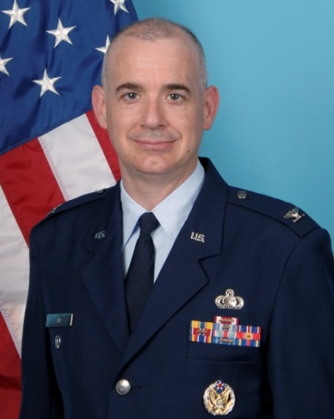
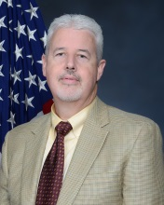
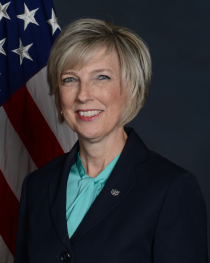
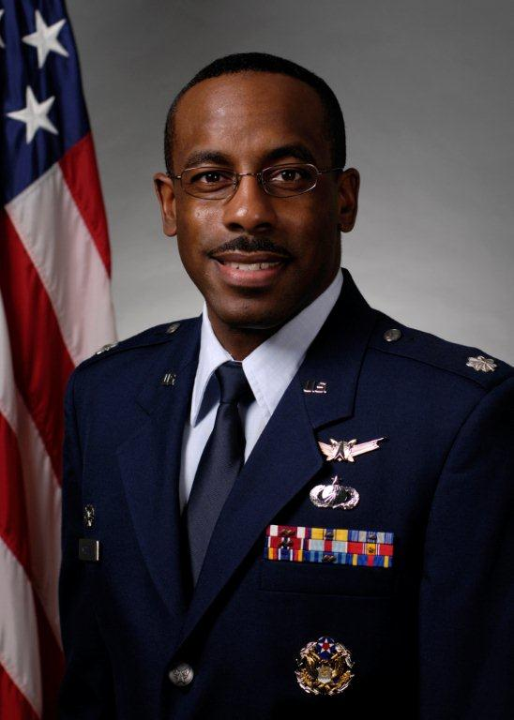
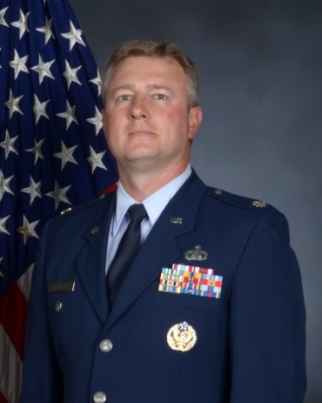
Local Contacts
U-2
Development/
Sustainment
SOF/PR & Rotary Division
Global Hawk
Sustainment
Predator/Reaper
Sustainment
AFLCMC/HBG
(AFLCMC/WIU)
AFLCMC/WIGA
AFLCMC/WIILR
Col Raymond Wier
Mr. Ronnie Carter
Mr. James Strickland
Mr. Winfield Tufts
Ms. Kimberly Herren
Lt Col Robert Mitchell
Lt Col William (Chris) Robinson
Cleared for Public Release
88ABW-2015-2181

Slide 7
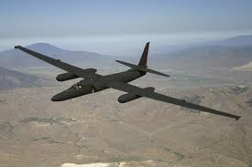
U-2 Breakout Program Forecast/Opportunities
The Breakout program partners with Original Equipment Manufacturers (OEM)s and small businesses to provide ground support equipment and associated spares for the U-2 Program at a lower cost through:
Repair
Remanufacture
Procurement
Reverse Engineering and Manufacturing
In conjunction with OEMs the Breakout program identifies items and releases limited rights data for items to third-party vendors with Non-Disclosure Agreements
Facilitates reverse engineering if OEM no longer supports item
Currently supports over 1,749 items

Slide 8
U-2 Breakout Programs Needed Capabilities
Machining
Computer Numerical Control (CNC)
Manual
Water jet
Fabrication
Sheet metal
Electrical
Fiber optic
Welding
Composites
Quality Control
Welding Certifications
Tolerance Inspections
ISO 9001/2008
AS 9100
Data Control
Textile
Industrial grade sewing
Clothing production
Material Processing
Sand blasting
Painting
Anodizing
Chemical etching
Design
Read/Interpret Blueprints
Reverse Engineering

Slide 9
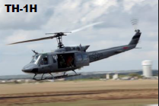
AFLCMC/WIU Acquisition Forecast/Opportunities
TH-1H Automatic Dependent Surveillance—Broadcast (ADSB) Mode 5
Description: Modification is to ensure that the TH-1H fleet meets the Federal Aviation Administration (FAA) mandate that all transponder equipped aircraft will be ADS-B Out compliant. This capability will provide Mode 5/ADS-B growth capability for improved identification of aircraft and additional flight information parameters provided.
Acquisition Approach: Small Business competitive
RFP Release: Third Quarter, 2016
Contract Award: Second Quarter, 2017
POP: 36 months

Slide 10
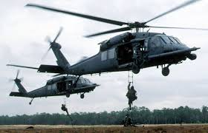
AFLCMC/WIU Acquisition Forecast/Opportunities
HH-60G Smart Multi-Functional Control Display (SMFCD) Production Kit Installs
Description: Install up to 65 SMFCD production kits into active duty HH-60Gs at approximately 6 locations worldwide
Acquisition Approach: competitive, small business (8(a) set aside)
RFP Release: Fourth Quarter, FY16
Contract Award: First Quarter, FY17
POP: 18 months

Slide 11
AFLCMC/WIU Acquisition Forecast/Opportunities
HH-60G Degraded Visual Environment (DVE)
Description: Integrate system capable of detecting obstacles in degraded visual environments (dust/snow/fog/…) and displaying cueing information to aircrew into HH-60G airframe & avionics architecture, provide production kits and perform installations
Acquisition Approach: Competitive
RFP Release: Second Quarter, FY17
Contract Award: Fourth Quarter, FY17
POP: 60 months

Slide 12
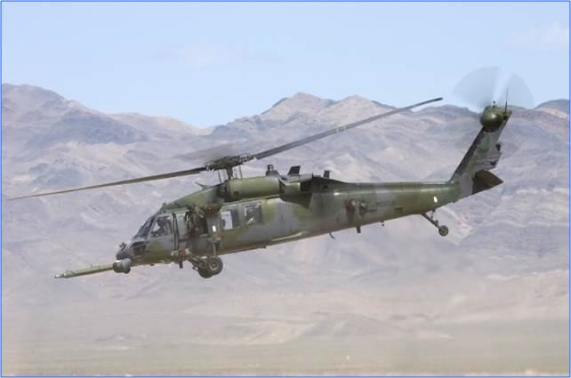
AFLCMC/WIU Acquisition Forecast/Opportunities
HH-60G Maintenance/TCTO Modification
Description: OCONUS (Pacific Theater) Depot Maintenance for the HH-60G helicopter airframe and repair of defects to ensure safe operation of the aircraft.
Acquisition Approach: competitive
RFP Release: Third Quarter, 2016
Contract Award: Third Quarter, 2017
POP: 60 months

Slide 13
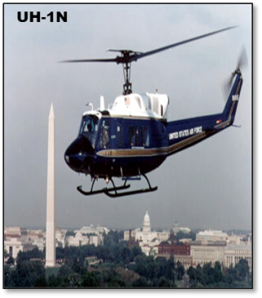
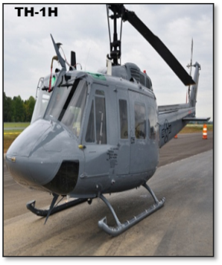
AFLCMC/WIU Acquisition Forecast/Opportunities
Reliability and Maintainability (R&M) for UH-1N, TH-1H, and HH-60G
Description: Full range of engineering research, integration and technical support services, isolation and analysis of R&M deficiencies, to support the development, implementation and sustainment of Reliability Centered Maintenance and Age Exploration programs.
Acquisition Approach: competitive, small business (8a set aside)
RFP Release: Second Quarter, 2017
Contract Award: Fourth Quarter, 2017
POP: 60 months (FY17-FY21)

Slide 14
AFLCMC/WIU Acquisition Forecast/Opportunities
Rotary Aircraft integrity Programs (HH-60, TH-1H, UH-1N)
Description: Provide Engineering Services Support for the SOF/PR Rotary Wing for Aircraft Structural Integrity Program/Mechanical Equipment and Subsystem Integrity Program and Avionics Integrity Programs (ASIP/MECSIP/AVIP)
Acquisition Approach: Competitive
RFP Release: Fourth Quarter, 2016
Contract Award: Second Quarter, 2017
POP: 60 months

Slide 15
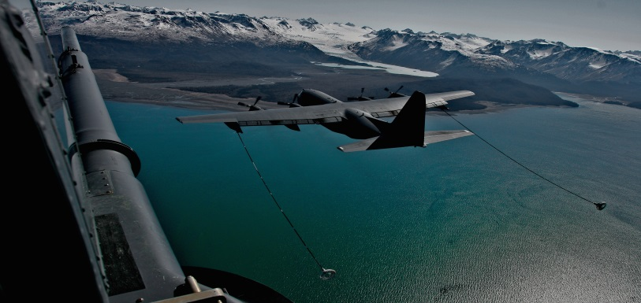
AFLCMC/WIU Acquisition Forecast/Opportunities
HC-130(H)N Two-Color Infrared Missile Warning Sensor (IR MWS)
Description: Procure and Install the NexGen Two-Color IR MWS sensors on 3-6 HC-130(H)N aircraft. The NexGen MWS will have higher spatial resolution, longer range, and quicker IR missile declaration warning over the existing UV MWS spectrum currently employed on the HC-130.
Acquisition Approach: Competitive, small business
RFP Release: Third Quarter, FY17
Contract Award: Second Quarter, FY18
POP: 36 months

Slide 16
AFLCMC/WIGA Portfolio Overview
RQ-4 Sustainment Branch at Robins AFB
Provides Contractor Logistics Support (CLS) for RQ-4 Weapon System
CLS: Spares, Repairs, Depot Level Maintenance, Software Maintenance, Field Service Representatives (FSRs), O-Level Maintainers, Supply Chain Management (SCM)
CLS Contractors
Northrop Grumman Aerospace Systems (NGAS): Prime
10 Major Subcontractors & Interdivisional Work Organizations (IWOs)

Slide 17
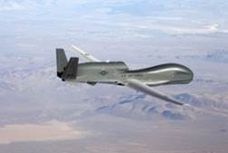
AFLCMC/WIGA Acquisition Forecast/Opportunities
RQ-4 Contractor Logistics Support and Sustainment contract (sole source)
RQ-4 Engine Overhaul contract (sole source)
RQ-4 Organizational Level Support (OLM) contract (ACC/A5 Assume Support 1 Jul 18)
Active Duty or Competitive Contractor Support
RQ-4 Contractor ICP Transitioning to Organic ICP
WIGA is exploring other opportunities for competition

Slide 18
AFLCMC/WIILR Portfolio Overview
MQ-1/MQ-9 Sustainment Section
Provides Contractor Logistics Support (CLS) for MQ-1 and MQ-9 Weapon Systems
CLS: Spares, Repairs, Depot Level Maintenance, Software Maintenance, Field Service Representatives, Supply Chain Management
CLS Contractors
General Atomics - Aeronautical System Inc. (GA - ASI): Aircraft and Ground Stations
Raytheon Space & Airborne Systems (SAS): MTS-A/B and ACES-HY Sensors

Slide 19
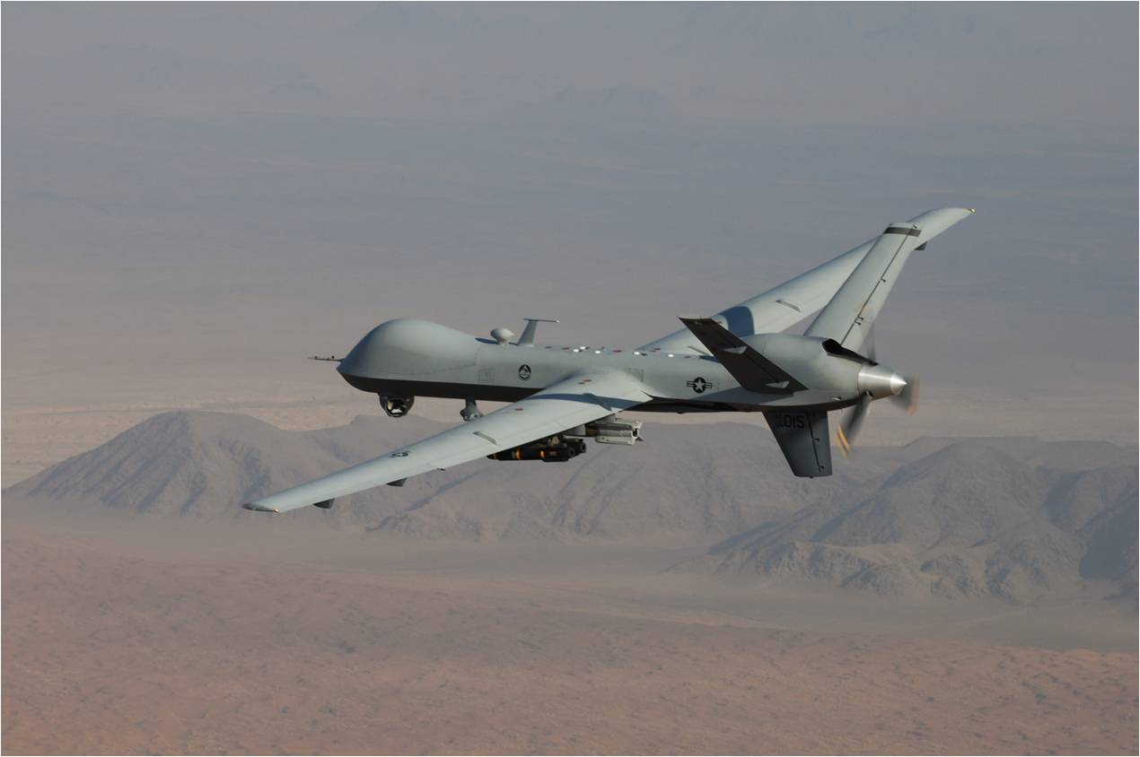
AFLCMC/WIILR Acquisition Forecast/Opportunities
In FY17, Squadron Operations Center site installation and technical refresh activities for stateside National Guard locations will be managed by 402d Aircraft Maintenance Group
In FY19, increased depot workload for MQ-9 data links, communications, sensor software, and aircraft parts, pending funding decisions

Slide 20
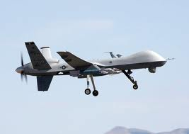
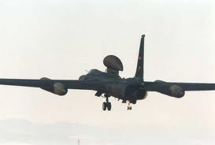
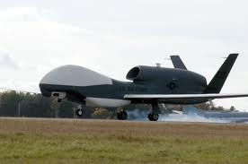
Other Future ISR & SOF Workload
U-2 Surrogate Test Platform
Global Hawk Sustainment
MQ-9 Reaper Sustainment
CRH Sustainment/Modifications
Special Ops C-130 Gunship/Penetrator SOCOM Programs
Support Equipment

Slide 21
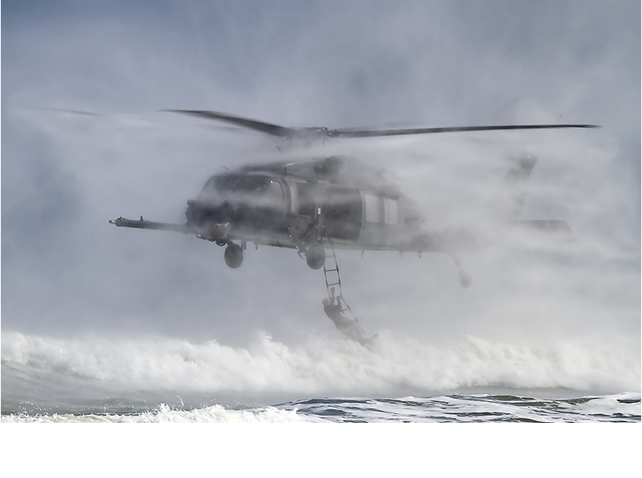
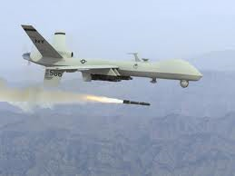
PEO ITEMS OF EMPHASIS
Rotary Wing Growth / Skills
Operational needs driving quicker acquisitions
Mission and Sensor Open systems
FMS/2282 Case Growth
Bending the cost curve
Competitive Opportunities

Slide 22
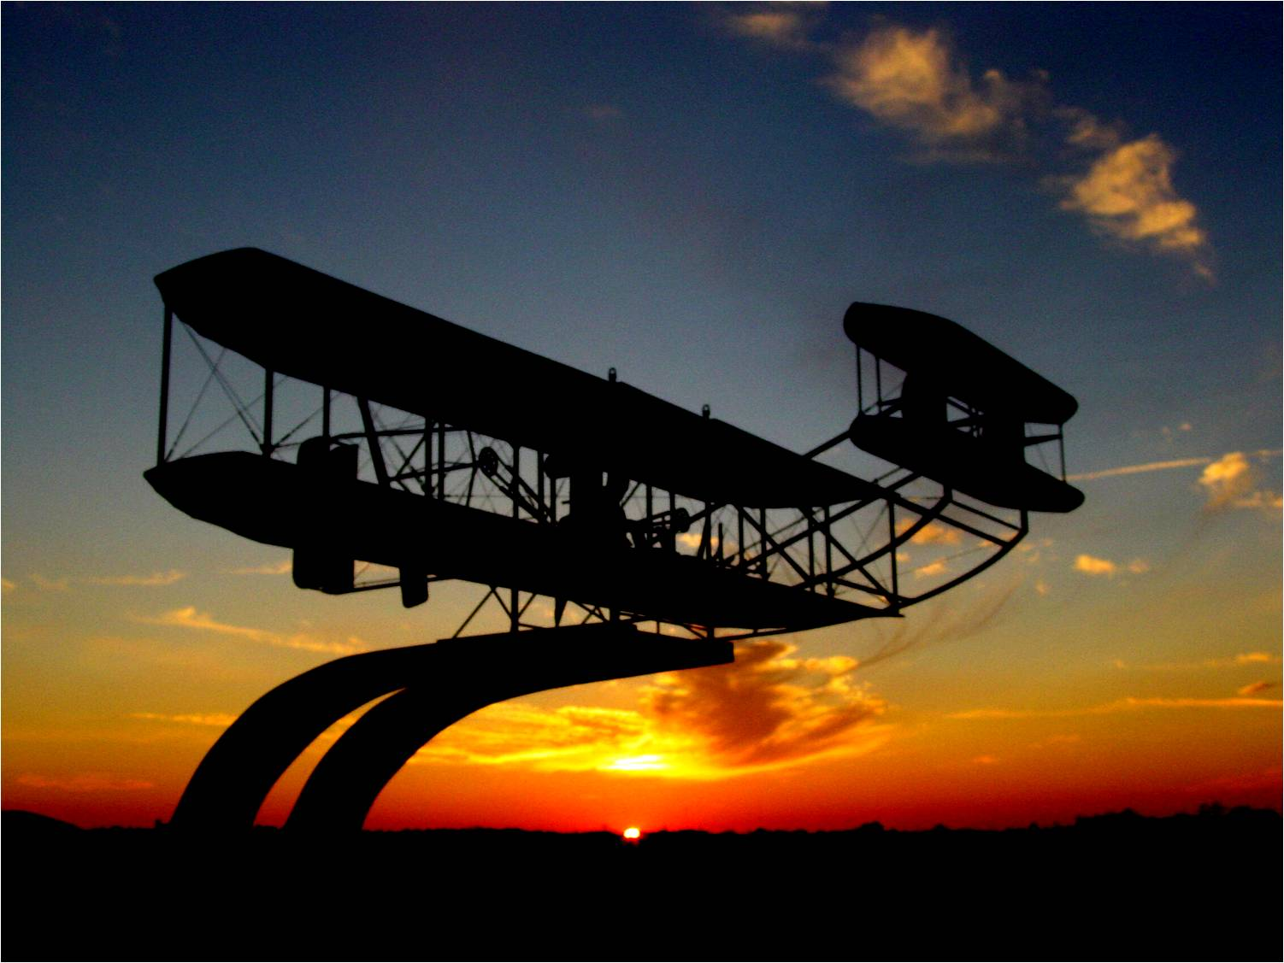
In Closing
ISR/SOF:
Provides Diverse Capability to the Warfighter
Meets urgent needs with speed and discipline
We D.I.G. in:
DELIVER•INNOVATE•GROW

