Slide 1
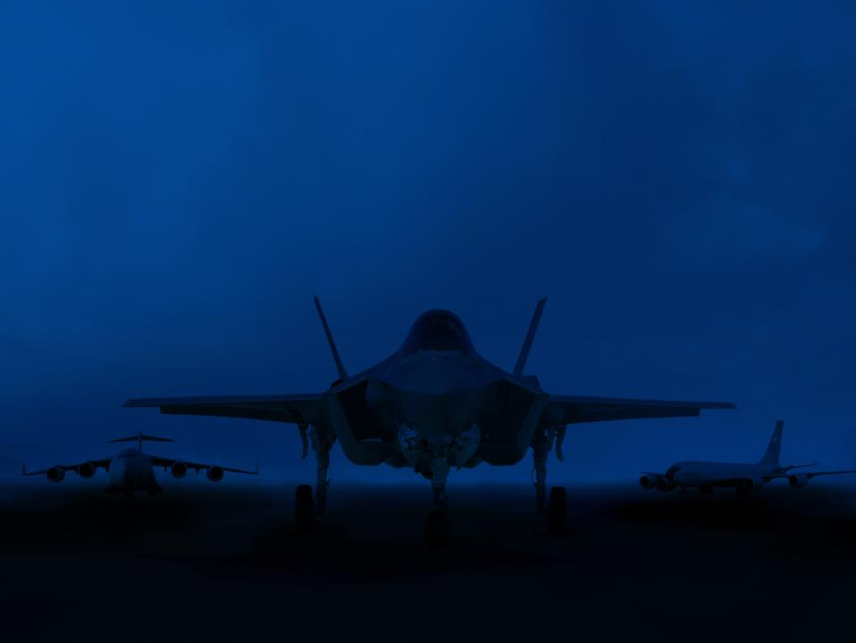
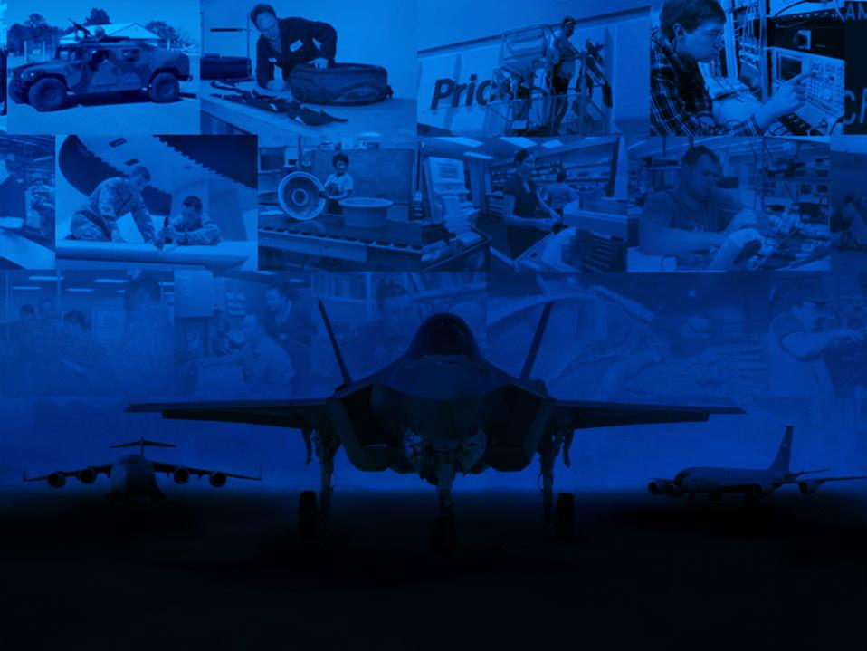

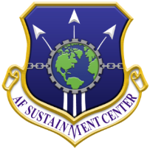
AIRSPACECYBER
March 2016
Lt Gen John Thompson
Commander, AFLCMC
Providing the Warfighter’s Edge!
Lt Gen Lee K. Levy, II
Commander, AFSC
Delivering Combat Power for America!

Slide 2
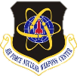

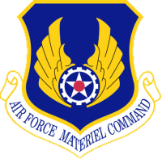

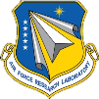





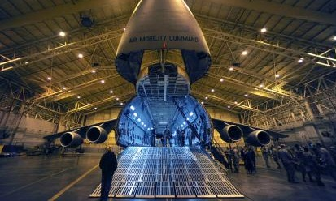



Air Force Materiel Command
Center Mission Areas
Nuclear Systems
Management
Continue to Strengthen AFMC’s Role in the Nuclear Enterprise
Discovery and Development
Advance Today’s & Tomorrow’s Combat Capabilities through Leading-Edge Technology
Life Cycle Management
Acquire and Support
War-Winning Capabilities “Cradle-to-Grave”
Perform World-Class Test and Evaluation
Test & Evaluation
Sustain Air Force Capabilities through World-Class Depot Maintenance & Supply
Sustainment & Logistics
Installation
& Mission Support
Support AF-wide Installation and Expeditionary Combat Support Activities

Slide 3

Where We’re Headed…
Cyber Resiliency
Additive Manufacturing
Condition Based
Maintenance Plus (CBM+)
Robotics
Working Together
Deliver and Support Agile War-Winning Capabilities

Slide 4

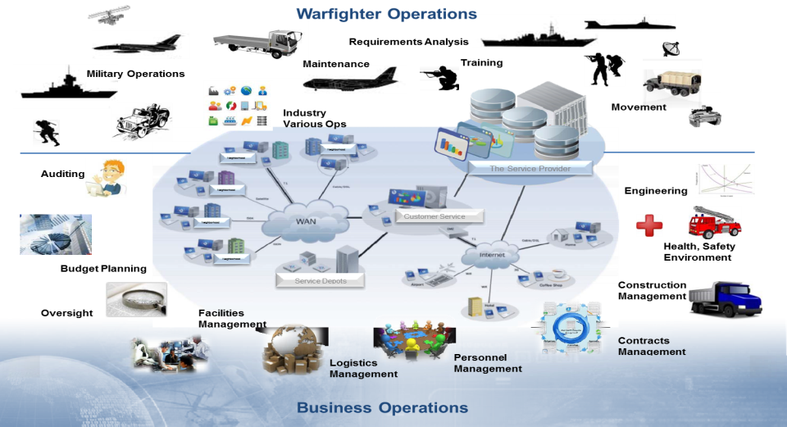
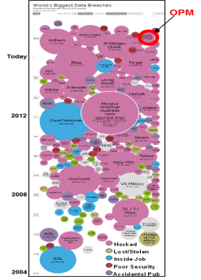
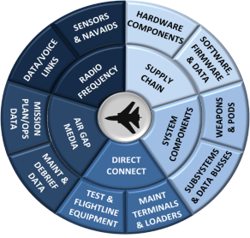

Cyber Threats -- Everyone’s Problem
Weapon Systems
(embedded systems)
“Big IT”
Critical Infrastructure
Wheel of Enlightenment
(aka Doom)
informationisbeautiful.net
Notes:
AFLCMC
New threats are constantly evolving and emerging on the cyber front
Nation state actors growing (China, Russia, Iran)
Terrorist organizations (ISIS, Al Qaeda)
Lone hackers
Traditionally, cyber threats were focused on IT systems, but now, infrastructure attacks are becoming more prevalent…both towards our weapon systems, and sustainment capabilities

Slide 5

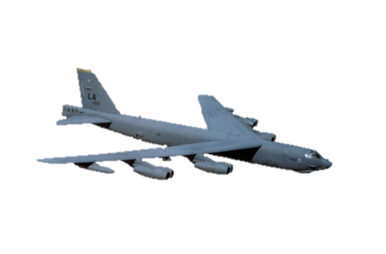
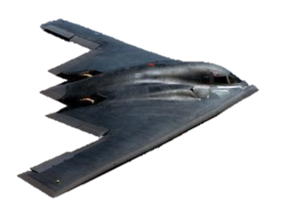
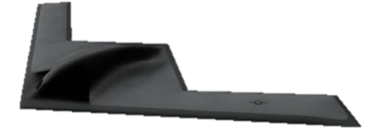
AFLCMC Roadmap to Resiliency
WALK
- Assess and Fix
CRAWL
- Mission Thread Analysis
RUN
- “Baked” in resiliency
Develop assessment methodology framework
Develop cyber acquisition workforce
Assess cyber posture of fielded systems
Enable weapon system adaptability
Institutionalized methodology, tools, T&E infrastructure
Skilled workforce
Integrated cyber tools, policy, etc.
Bolted-on Baked-in
Present
Future
Notes:
AFLCMC
AFLCMC is just beginning the weapon system cyber resiliency journey (BUILD CHART)
Crawl
Primary focus right now is to develop the a common, repeatable methodology that we can apply to weapons systems to find risks/vulnerabilities
FY18 Planning choice provides initial funding to start
Team is standing up
Limited fixes are being put in place right now (bolted-on)
Walk
Once methodology established, we will use it to assess current systems to determine vulnerabilities/risks
Meanwhile, AFLCMC is currently promoting open systems architectures so that we can implement OSA during the walk phase
Run
Future state we will have systems/tools/processes in place to “bake” cyber resiliency into systems from the start.
Tremendous amount of work to get to this state, but we must get here to ensure mission assurance.
Systems need to be born with cyber resiliency and easily modded and sustained (late development)
Enable cyber resiliency during recurring hardware & software updates

Slide 6

AFSC Cyber Concept
Bolted to Baked
Global Log Integration & C2
Management of Supply Chains
Security of networked operations
Must be in parallel with weapon systems to get to “baked”
No “Forward” and “Rear” distinction
Fundamental for the agility needed in evolving battlespace
Global LOGNAF C2 requirement
Bolted-on Baked-in
Present
Future
Notes:
AFSC
Bolted to Baked
Already breaking old “cylinders of excellence” and taking a global view of logistics processes (WRM, CEMO, AFPET) continuing a road we’ve been on with parts (centralize MICAP management)
Supply chain network security is a concern for everyone in this room….today not just in the future. This isn’t a “Comm” problem it is an operational problem that needs the senior leader’s focus—not the “IT guys or gals”
As we move from Bolted to Baked JT and my organizations will be in parallel, we talk often and our teams know that. It drives the right behavior in large organization when the senior leaders are in constant communication and moving forward to the same objective
Global Log Integration and C2
It will not be “the way it was” – no distinction between battlefield in a far off country and our CONUS bases
Being globally integrated won’t be a “nice to have” it will be the only way we can be successful in a threat environment with limited resources…
We must have the agility to C2 log operations in sync with operations to not be behind the pitch
Agility is needed because the battlespace will continue to change—no “Maginot Lines”
We can’t buy and do everything, we need to buy, do, and position the right things rapidly to meet the Joint Force Commander’s needs. Global LOGNAF will need to shape outcomes not react to them – global log integration and C2 is a “must have” to accomplish that

Slide 7
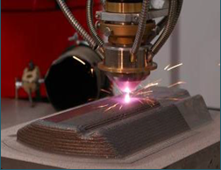
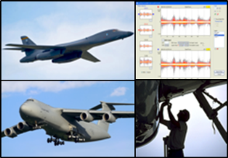
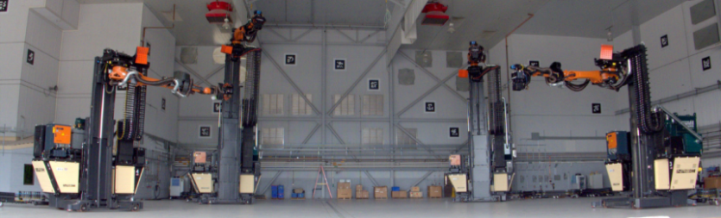
Technology Initiatives
Additive Manufacturing
Condition Based Maintenance Plus (CBM+)
Robotics
Notes:
AFLCMC
While in AFLCMC we have to plan from cradle to grave, there are a lot of awesome things in the tech realm that are pursued and implemented
AFSC
There’s been a lot of “technology buzz” lately within the Department of Defense
Technology will likely be the key to us maintaining our advantage over potential adversaries
But technology is also the key to unlocking more effective and efficient ways of maintaining our fleets of aircraft and ground systems
Things like: Additive Manufacturing, Tools for Fleet Management, and Advanced Robotics
Let us share a couple of these thoughts with you…

Slide 8
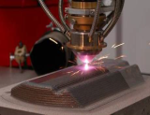
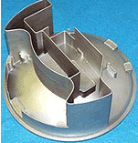

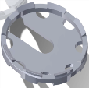

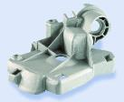

Additive Manufacturing (AM)
CRAWL – Immediate Value
Hybrid tooling/ fixtures integrated with metal subcomponents
Rapid prototyping for form, fit, and function
Tools, fixtures, prototypes, non-critical parts
Start supply chain re-design
WALK – Mid-Term Outlook
Manufacture of metal fixtures, masks, and jigs for repair process
Manufacture of DMSMS components
Manufacture of non-rotating and structural aircraft components
Continue to redesign supply chain to support
RUN – Game-Changers
Effective dimensional metallic restoration of propulsion items
Better microstructural control
Manufacture of parts On-Demand
Near Net Form Castings & Extrusions
Fully redesigned supply chain and ops plans
Ensuring the new frontier for the warfighter of the future
Notes:
AFSC
First is Additive Manufacturing, or “3-D Printing”
This has been in the news a lot…from printing artificial limbs to prototypes of car parts to the Navy’s “Print the Fleet” initiative
This is an area with huge potential…but there’s no “easy button” to get to the tough stuff…the metals, the structural components, the stuff with really really tight tolerances and little room for errors or nonconformities
So we’re starting slow…speed with discipline
For example, we’re looking into fixtures and non-critical parts as a starting point
Recently the F-35 was unable to procure protective covers for its wingtip navigation lights
So, our Advanced Composite Office reverse engineered the vacuum mold tool and we’re on our way to manufacturing covers

Slide 9


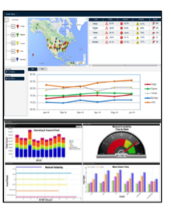
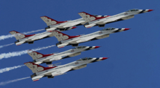
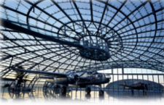
Condition Based Maintenance Plus (CBM+)
CRAWL – Immediate Value
Capitalize on existing pockets of excellence
New perspective utilization of existing data and domain expertise
Enhanced field Mx operations (MOB/AOR)
Standardized processes to adopt predictive prognostics and monitoring
Enhanced data integrity tools/suites & training
WALK – Mid-Term Outlook
Field + Depot Mx data set mash-ups and indicators
Integration of corrosion, NDI, and other key conditional information sets (sensor feeds)
Enhanced data integrity tools qualified for enterprise
Cyber secure, collaborative and full-scale accessible environment
Sustain over time.
RUN – Game-Changers
Active CBM+ monitoring across USAF enterprise (organic + CLS)
Real-time, state of the art data integrity systems
Full-scale use of AIT and point of Mx tools
Fully integrated engineering, supply & logistics operations = no unplanned Mx
Ultimate Goal: Reduce…to Eventually No Unplanned Mx!
Notes:
AFLCMC
Adopt and integrate CBM+ predictive prognostics & principles
Identify “top 5”
CBM+ components
Aircraft downtime
Mission impacts (aborts)
High cost drivers
Demonstrate CBM+ monitoring techniques and principles
Evaluate next generation data cleansing and engineering data analytics tools
Enhance data integrity
Support by-tail condition analyses
Performed trending and computational analyses of Mx data
Completed MOB maintainer operations assessments
C-5 MOB visits: Dover & Travis AFBs
B-1 MOB visits: Dyess & Ellsworth AFBs
Completed C-5 MSG-3 certification deep dive
Initiated B-1 MSG-3 and RCM practices deep dive
Completed initial review of B-1 Aspire tool (point of Mx data entry & TOs)
Initiated viability assessment of automated identification technology (AIT)
Initiated “test drive” of data cleansing and analytical suites

Slide 10
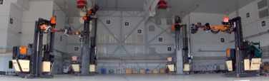
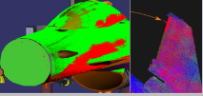

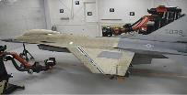
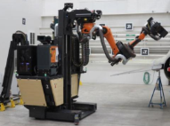

Robotics Strategy
CRAWL – Immediate Value
Robotic Laser De-painting Initiative (RLCRS)
Implemented on F-16 and C-130 at Hill AFB
Implementing on C-130 at Robins AFB in FY16
WALK – Mid-Term Outlook
Implement RLCRS across organic depot Mx, CLS, and trainers maintained by AETC
De-painting is just the beginning…initiate multi-functional efforts (i.e., next potential robotic focus = NDI)
RUN – Game-Changers
Multi-purpose robotic systems from one foundation:
  ONE SYSTEM to NDI + De-Paint
  ONE SYSTEM to Clean + Paint
Enables next generation Mx practices
Robotics and laser technology empowers aerospace innovation!
Notes:
AFSC
How about painting and depainting? Consider what the Sustainment Center is doing at Hill on F-16s
Flow days were cut by over 50% and costs were cut by 75%
Hazardous waste has been nearly eliminated
These technologies are being implemented on C-130s as well
We’ve all seen how a concept that is only Science fiction in a theater or on TV becomes just a part of how our world operates (Star Trek communicators to cell phones/blue tooth technology, mini devices in the 80s that looked much like an IPAD, there are many….
While we aren’t at the Iron Man level in DOD, we know this is our future, it isn’t a luxury, it is a necessity
Partnership with the Sustainment Center, the SPOs, the Labs, and others, are important to deploy technology into the current industrial environment to make us more efficient and effective with todays weapon systems – we can’t wait to implement of future generation aircraft
Robotics offers numerous advantages for virtually every type of operational process
Reduces flow days
Reduces cost
Offers increased worker occupational health and safety
Offers multi-functional platforms
Training is critical to success of robotic applications
Need to address worker skill requirements for robotic operations
Expanded worker opportunities (i.e., certifications, capabilities)

Slide 11
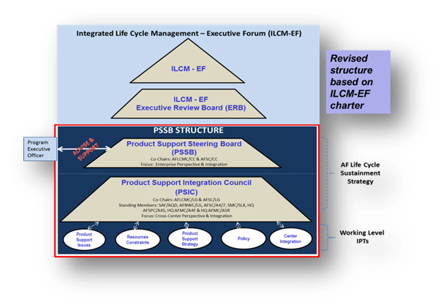
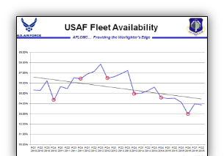
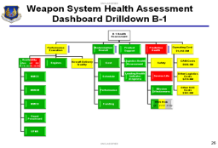
How We Work Together
Integrated, Focused, Transparent
Product support strategies that address and anticipate problems areas and resolve mission-critical constraints in advance of the crisis
Aircraft Availability Improvement Program (AAIP) sync’d with customer expectations, focused on investments with biggest gains in AA, modernization, Predictive Health and cost effectiveness
Weapon System Execution Reviews (WSER) tracks execution from the “shop floor to the Chief’s door”
Notes:
AFLCMC & AFSC
PSSB - The Product Support Steering Board (PSSB) provides an executive level stakeholder forum chaired by AFLCMC/CC and AFSC/CC to review enterprise life cycle product support and sustainment related activities with a mission to provide an enterprise perspective to enhance decision making within the Program Executive Officer (PEO) portfolios.
AAIP - Aircraft Availability Improvement Plan – a process to develop transformation initiatives that facilitate increased weapon system availability, increased mission capability, improved repair capability, and reduced costs. Actionable plans are developed jointly by PMs, Lead Commands, and AFSC
WSER- Provides a comprehensive, integrated, timely, and rhythmic (Quarterly) review focused on:
present and future health of Air Force weapon systems
overall AFMC Integrated Life Cycle Management (ILCM) effectiveness
AFLCMC and AFSC work together in two key areas:
Team to ensure high quality of aircraft depot work
From requirements documentation/workload planning through work package execution and delivery of aircraft back to the unit
If Aircraft Inspection Deficiency Report rate exceeds standard, team initiates 8-step process to identify root causes of workmanship defects and implement countermeasures (e.g., B-52)
Collaborate to meet supply challenges
AFSC’s MICAP analysis of Air Force- and DLA-managed items reveals current/future drivers negatively impacting not mission capable (for supply), or NMCS, rates
-- Reports include constraint/mitigation/get well date information which enable AFLCMC & MAJCOMs team members to actively manage the fleet
Slide from Steven Gray/LGS

Slide 12

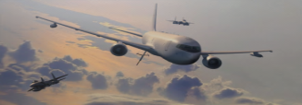
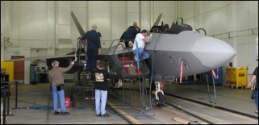

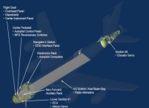
Teaming/Relying on Each Other
Life Cycle Management
Organic Sustainment
Warfighter Expectations:
Fight Tonight, Ready Tomorrow
Deliver cost-effective readiness as we drive to Art of the Possible
KC-135 Block 45
Mod Aircraft
KC-46 Acquisition and Organic
Management
AFSOC C-130 PDM Acceleration
F-35A IOC Depot Mods
Notes:
BOTH:
KC-46A: LCMC and AFSC team are working together with Boeing to stand-up organic sustainment of KC-46A aircraft PDM, commodities, software, and supply support assuring FAA commercial type certification. Additionally, AFSC is actively engaged with the required MILCON projects.
AFSOC C-130 Acceleration: AFSOC asked WR-ALC to accelerate all C-130 through PDM in FY16. Acceleration drives challenges in supportability. Depot maintenance, supply chain, and SPO partners are working together to pull delivery dates to the left to meet production/customer requirements.
KC-135 Block 45 MOD: LCMC and AFSC are addressing aging issues on KC-135 Block 45 modification on the KC-135 to make needed cockpit upgrades. Mods are scheduled over the period FY14-FY22.

Slide 13
Bottom-Line
Cyber resiliency is a baseline requirement
Enhance adaptability of weapon systems
Technology is critical:
  Maintaining advantage over potential adversaries
  Unlocking more effective and efficient ways of maintaining our fleets of aircraft and ground systems
  Working together is key
Deliver and Support Agile War-Winning Capabilities
Notes:
AFLCMC & AFSC
Cyber Resiliency as a baseline requirement within each weapon system.
Capturing Cyber security & resiliency in key acquisition documents
Enhance adaptability of weapon systems to enable rapid response to emerging threats (Open System Architecture)
Additive Manufacturing / 3D Printing
CBM+
Robotics

Slide 14

Providing the Warfighter’s Edge!
Delivering Combat Air Power for America!

