Slide 1
Agile Combat Support Program Executive Officer (PEO) Review and Outlook (R&O)
Ms. Lynda Rutledge
AFPEO/ACS
24 March 2016

Slide 2
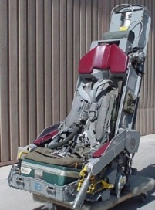
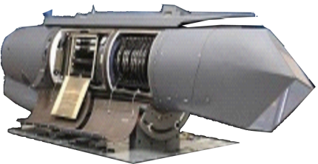
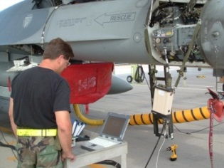
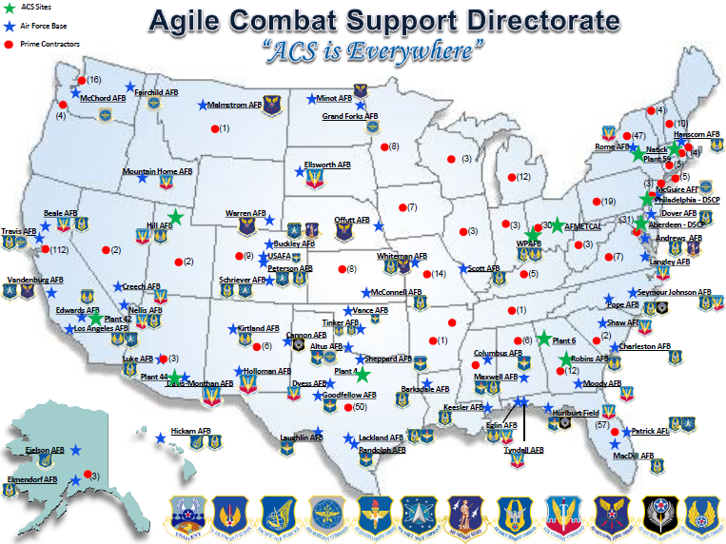
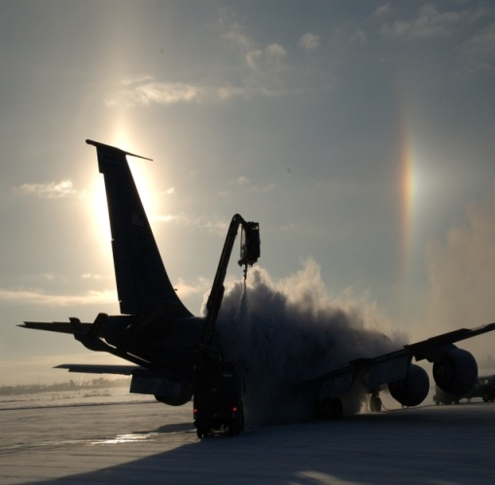
Who is ACS?
600+ programs/efforts
26 AML
150 Product Support
100+ IML
1 UON
200 FMS
150 service contracts
1800 people
$18.9B across FYDP USAF & FMS
Provides:
Human Systems
Electronic Warfare & Avionics
Automatic Test Systems
Support Equipment & Vehicles
Simulators
AFMETCAL
Acquisition Environmental & Industrial Facilities

Slide 3
ACS – Our Impact

Slide 4
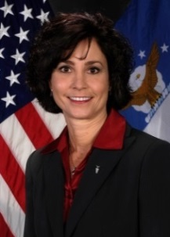
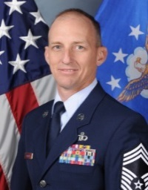
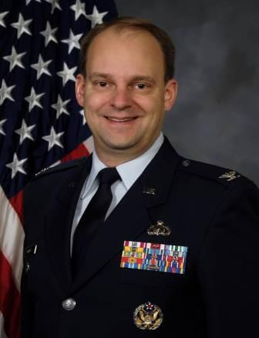
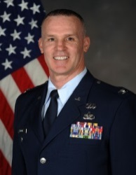
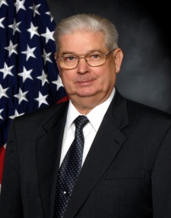
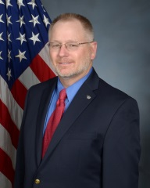
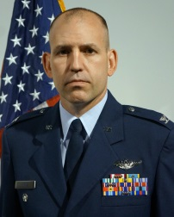
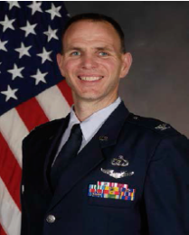
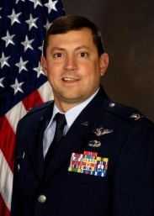
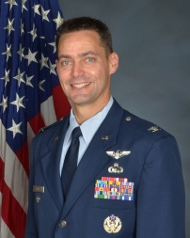
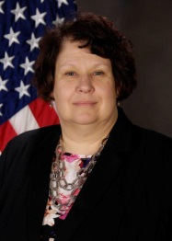
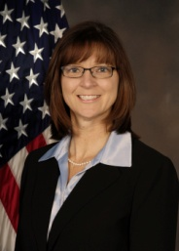
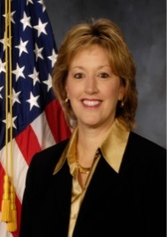
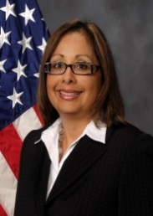
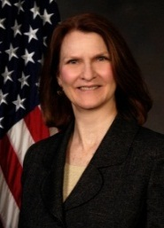
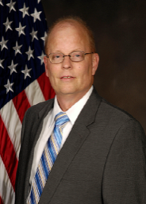
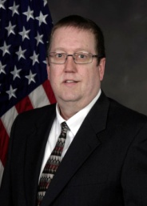
Agile Combat Support Directorate
Vacant
Position is being filled
CMSgt Jonathan Redfern
Chief Enlisted Manager
Colonel Gregory McNew
Deputy PEO/Director
Ms. Lynda Rutledge
PEO/Director
Colonel James T. Moore
Director’s Senior IMA
Mr. Alex Briskin
Chief, Acq Env & Industrial Facilities Div
Mr. Paul Kube
Chief, AFMETCAL
Div
Mr. Jimmy Bailey
Chief, Auto Test Sys
Div
Colonel Earl Stolz
Chief, EW & AV
Div
Colonel William (Chip) Mosle
Chief, Human Sys
Div
Colonel Daniel Marticello
Chief, Simulators
Div
Colonel Jeffry Gates
Chief, Spt Equip/Veh
Div
Photo
Forth-coming
TBD
Ms. Vicki Fry
Chief , Contracting
Ms Kristin Scherer
Chief, Financial Management
Ms. Jacqueline
Janning-Lask
Director of Engineering
Ms. Cheryl Ferrell
Chief , Logistics
Ms. JoAnn Freburg
Chief, Management
Operations
Mr. Dennis Deitner
Chief, Portfolio
Analysis
Mr. Ron Hannan
Chief, Security
TBD
Chief, FMS
4

Slide 5
PEO Priorities
Cyber Resiliency—Building security-in future acquisitions; proactive management of current threats
Driving down contract award timelines
More frequent/earlier communication with industry
Instilling agile, life cycle management mindset across Directorate
Creating more competitive and small business opportunities
Adopting Modular and Open Systems Architecture

Slide 6
ACS Portfolio

Slide 7
Support Equipment & Vehicles (SE&V) Product Line

Slide 8
SE&V Acquisition Contract Value & Type Breakdown
Sole Source, 10
Competitive, 18

Slide 9
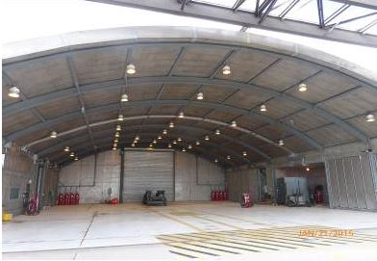
Noise Suppression System/Fire Suppression System (NSS/FSS) Sustainment Contract
Requirement
Noise Suppression System (NSS) and Fire Suppression System (FSS) sustainment
Lead Command: AFMC
Supporting Commands: ACC, AETC, AFGSC, AFRC, AFSOC, AMC, ANG, PACAF, USAFE
Acquiring Organization: AFPEO/Agile Combat Support, Support Equipment & Vehicles Division, AFLCMC/WNZ
Background Info
This will be a long-term contract to combine NSS & FSS sustainment, support , and upgrades for all NSS & FSS models
7 different NSS types
126 total CONUS & OCONUS units
Competitive; approximate value $300M+
Notional Schedule
Acquisition Planning Start Oct 15
RFI Dec 15
Industry Day Dec 15
ASP Jul 16
Solicitation Dec 16
Award Oct 17

Slide 10
Towbarless Tow Vehicle (TTV)
Requirement
The Air National Guard (ANG) is requesting procurement of 50 Towbarless Tow Vehicles(TTV) to be used for pre-position of aircraft (A-10, F-15, F-16, F-22 and F-35) in confined spaces. Eliminates tow bar need.
Funded by: ANG
Acquiring Organization: AFPEO/Agile Combat Support, Support Equipment & Vehicles Division, AFLCMC/WNZD
Background Info
New acquisition of a vehicle capable of meeting requirements within ANG specification
Market Research identified 10 Small Businesses capable of manufacturing TTV
Notional Schedule
Acquisition Planning Start May 15
RFI Aug 15
Estimated RFP Jun 16
Estimated Contract Award Jan 17

Slide 11
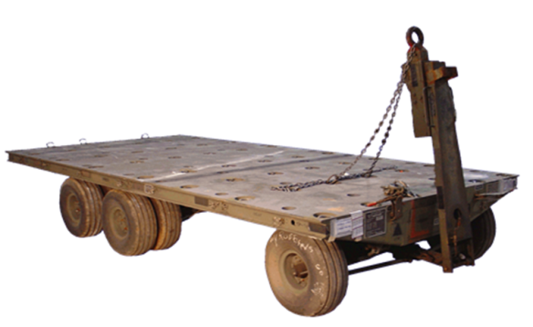
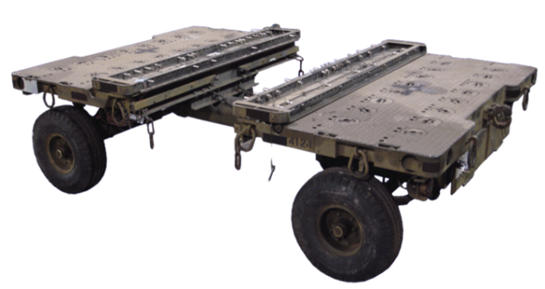
MHU-110/MHU-141 Munitions Trailer Replacement Program
Requirement
Used for temporary storage & transportation of munitions. Nuclear certified and can be used for conventional and nuclear munitions.
Lead Command: ACC
Supporting Commands: All MAJCOMs
Acquiring Organization: AFPEO/Agile Combat Support, Support Equipment & Vehicles Division, AFLCMC/WNZB
MHU-110
MHU-141
Background Info
Will design/test/deliver initial production units to begin recapitalizing legacy ~6K MHU-110/141 trailer fleet (MHU-110: 1,593/MHU-141: 4,322) which ended production in 70’s and is near the end of its 2nd service life.
Due to extended service life, both trailers experiencing significant sustainment issues such as parts obsolescence and structural fatigue (cracked welds, metal fatigue, etc.).
Notional Schedule
Acquisition Planning Start May 13
RFI May 15
Industry Day Oct 15
RFP 4Q FY16

Slide 12
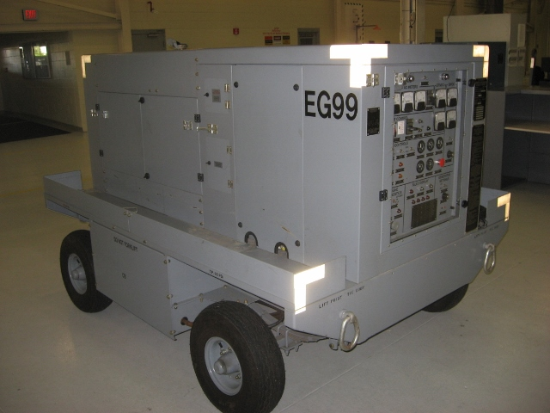
72kW Flight Line Generator Set Upcoming Acquisition
Requirement
Diesel engine driven source of electrical power which provides 72kW (90KVA), 115/200VAC, 3-phase, 400Hz, 28 & 270 VDC power used for starting aircraft and various ground maintenance tasks
Lead Command: ACC
Supporting Commands: All MAJCOMs
Acquiring Organization: AFPEO/Agile Combat Support, Support Equipment & Vehicles Division, AFLCMC/WNZB
Procuring Generator Set similar to B809E
Background Info
Replaces 72kW flight line & 60kw gas turbine engine generator set fleets. Comprised of 7 models, dating back to ’79. 60kW fleet is comprised of 3 models dating back to ‘64.
Will acquire 5K-6K units to replace all legacy 72kW and 60kw generator sets. Requirements include AF, sister services, and FMS customers.
Notional Schedule
Acquisition Planning Start Aug 16
RFP Dec 16
Award Jul 17
Testing 4Q FY18 -
2Q FY19
Production Readiness 3Q FY19
Production Units Order 4Q FY19

Slide 13
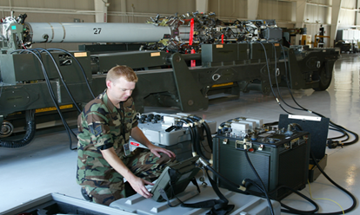
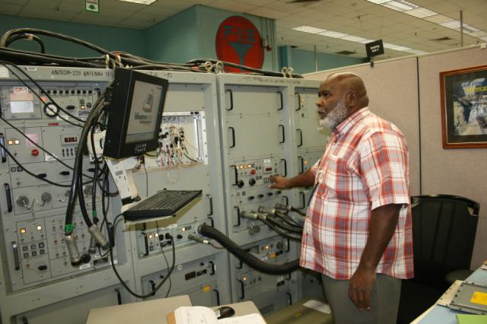
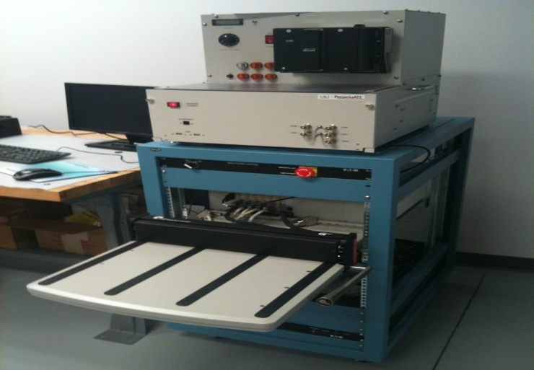
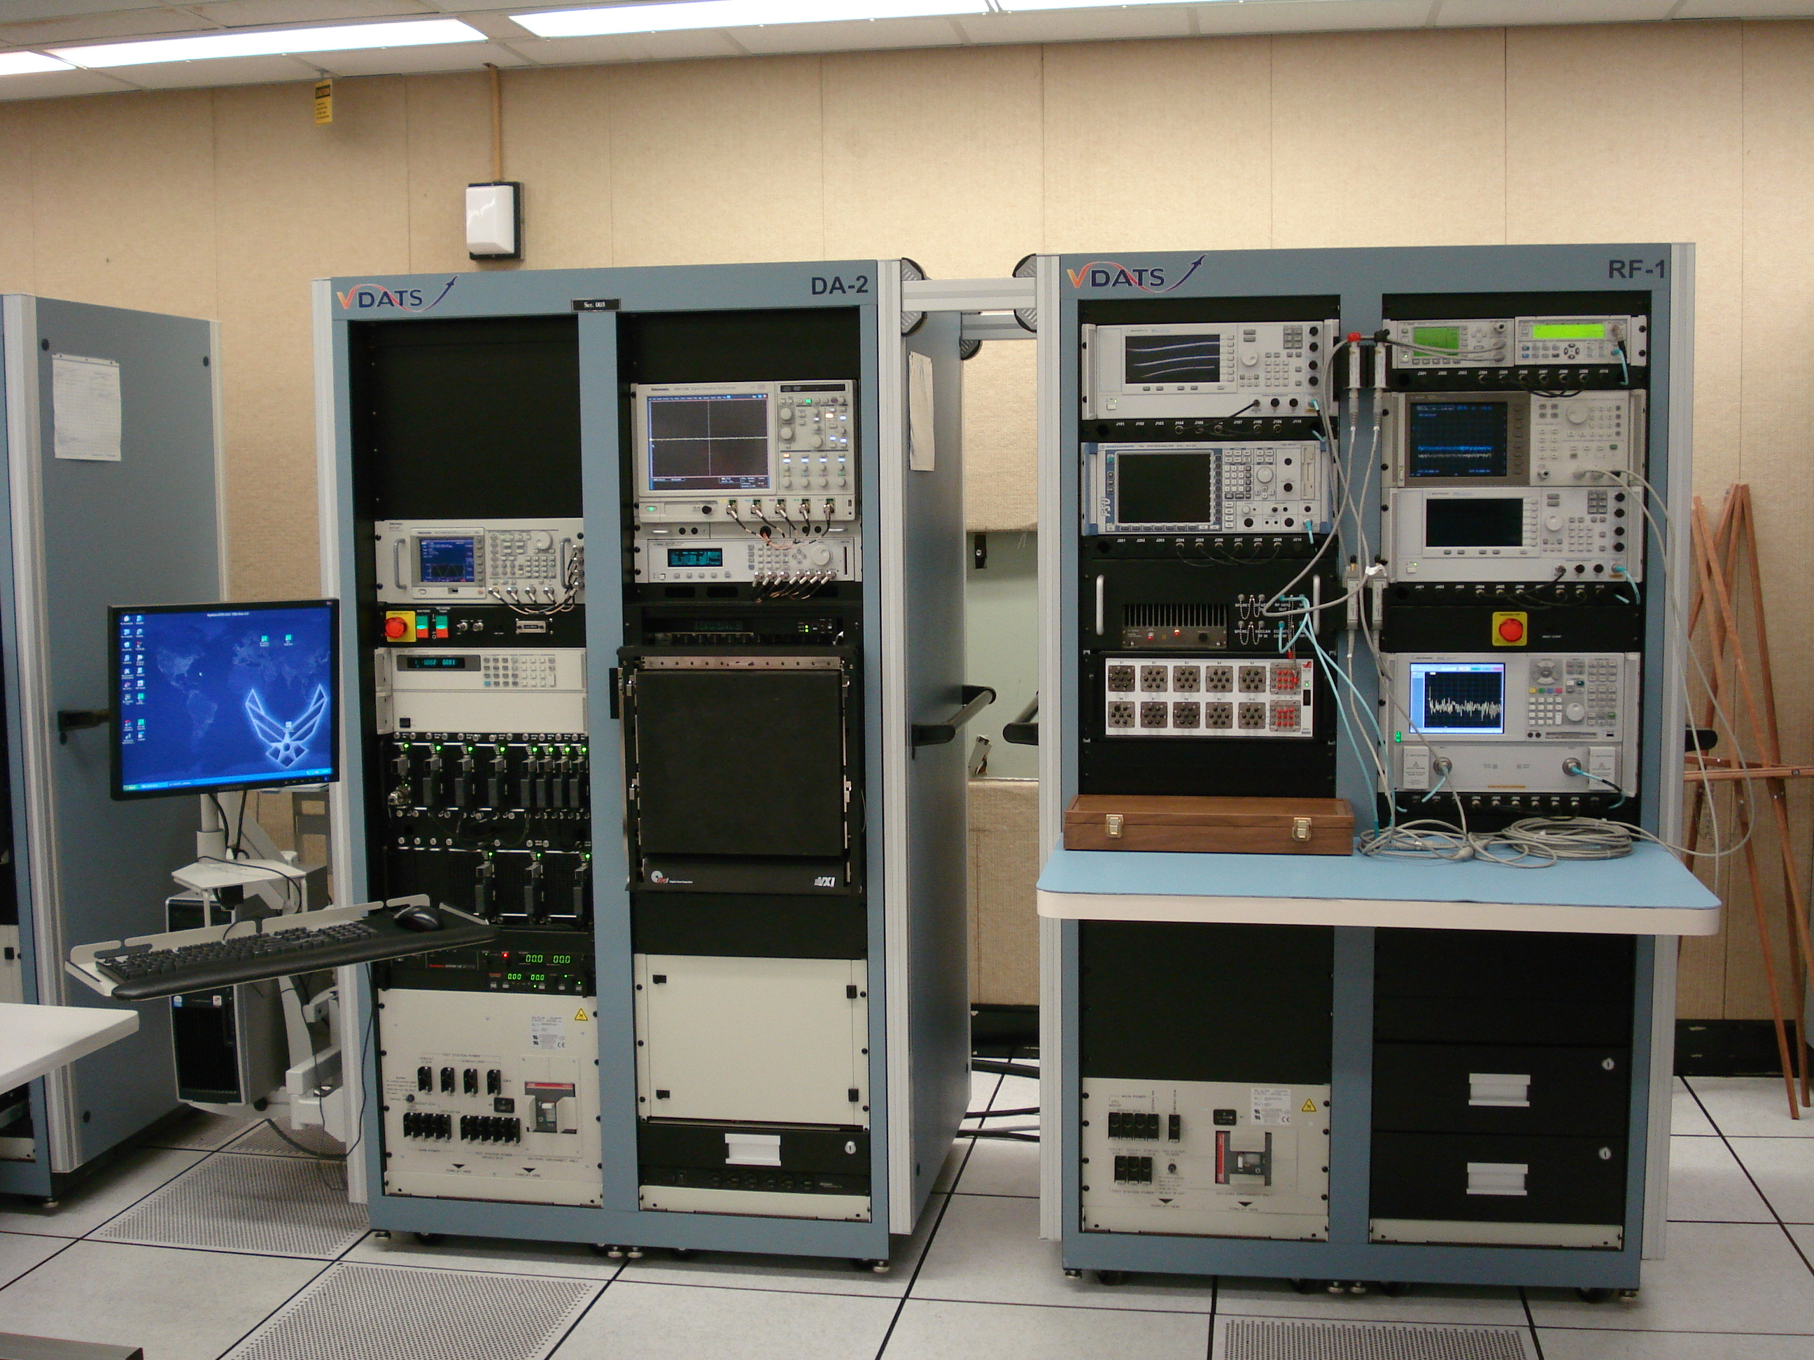
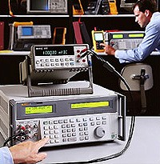
Automatic Test Systems
Product Line
ATS Program Groups
Organizational Level
COLT
IFF
CAPRE
Intermediate Level
F-16/A-10/C-5 AIS
F-15 AIS
B-1 ARTS
CM-ATS
Depot Level
VDATS
CBATS
TMDE
Meters
Analyzers
Calibrators
Test Sets
Common Organizational Level Tester
F-15 AIS
CBATS
Versatile Depot Automatic Test Station
Every mission requires ATS test solutions!
TMDE

Slide 14
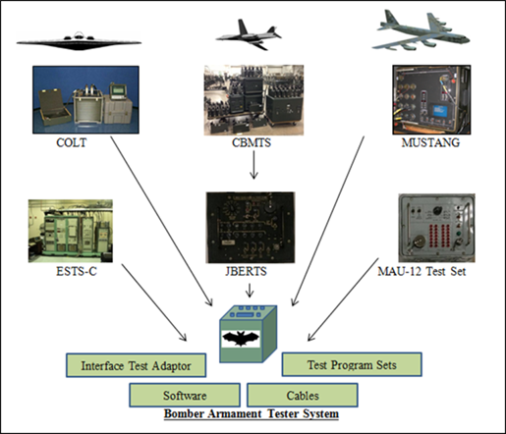
Bomber Armament Tester
Requirement
Develop a common reliable, deployable, nuclear certified, cyber secure bomber armament tester for B-1, B-2 and B-52
Lead Command: AFGSC
Supporting Commands: AFMC
Acquiring Organization: AFPEO/Agile Combat Support, Automatic Test Systems Division, AFLCMC/WNA
Background Info
Merges functionality of six obsolete legacy bomber testers (MUSTANG – Multi-User System Tester Armament Next Generation, COLT – Common Organizational Level Tester, CBMTS – Conventional Bomb Module Test Set, ESTS – C – Electronic System Test Set (Model C), JBERTS – Junction Box Ejector Rack Test Set, MAU-12 – Munitions Adapter Unit) into a deployable, nuclear-certified, self-test capable, testing unit
Schedule
Acquisition Planning Start Oct 14
RFI Sep 14/Dec 15
Industry Day Feb 15
RFP Jun 16
Award Mar 17
Fielding Aug 19

Slide 15
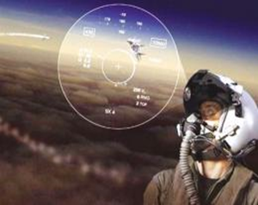
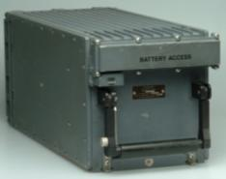
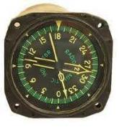
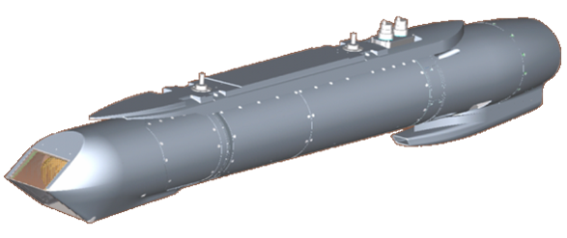
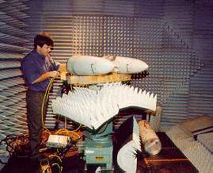
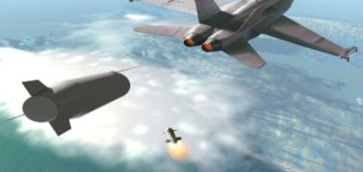
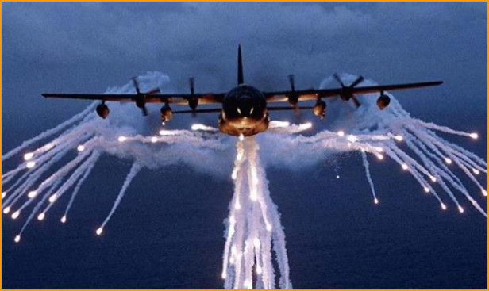
Electronic Warfare & Avionics Product Line
Common Avionics
Targeting, Navigation, and IRST Pods
GPS User Equipment
Ground/Airborne Comm and Nav Systems
Data Links/Gateways
Electronic Warfare
Electronic Countermeasures/Jammers
Radar Warning Receivers
Chaff/Flare Dispensers
Missile Warning Systems
“We’re on board every mission!”
Notes:
The Automatic Test Support Group provides our nation’s war fighters and allies the most combat capable and affordable Automatic Test Systems (ATS) in the world. They manage and maintain ATS over its life cycle and are responsible for the identification, acquisition, and sustainment of all Air Force common ATS and Test, Measurement, and Diagnostic Equipment (TMDE) supporting USAF, Joint Services, FMS and U.S. Coalition customers as well as the management of 21,000 NSNs.
The Support Equipment and Vehicles Sustainment Group provides our nation’s war fighters and allies the most combat capable and affordable support systems in the world. They ensure maintenance and management of support equipment over its life cycle and are responsible for managing the sustaining all Air Force vehicles, ground support/propulsion support/life support equipment, and Air Force Basic Expeditionary Airfield Resources (BEAR). They are responsible for the management of 42,072 equipment NSNs and 10,000 plus; NSNs for spares.
The Materiel Support Group provides our nation’s war fighters and allies the most combat capable and affordable logistics support in the world. The focal point for all matters concerning supply chain management business activities, Commodity Councils, logistics transformation, contract depot maintenance, and logistics data and system support. Policy, guidance and support are provided for major activities that include logistics management systems, equipment and stock fund item buy and repair requirements, stock fund, management of worldwide inventory levels, end items of equipment, Foreign Military Sales, Contract Repair and management, acquisition, storage, reproduction and distribution of technical data for WNZ managed items.

Slide 16
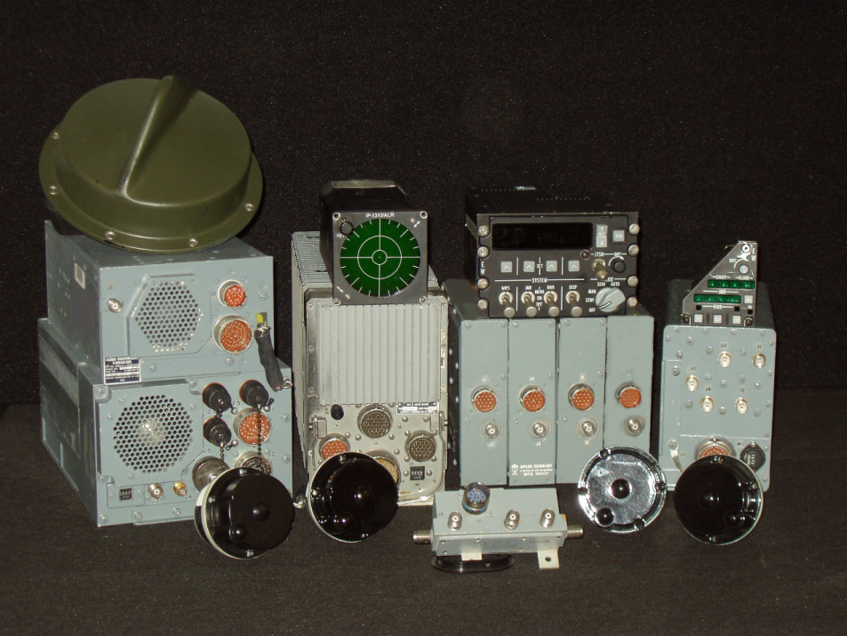
ALR-46/69 Radar Warning Receiver Hardware/Software Sustainment
Requirement
Contract for 30% support of Block Cycle (and non block cycle) software maintenance tasks, deficiency investigations, hardware redesigns, and lab maintenance
Lead Command: ACC
Supporting Commands: AFMC, ANG, AFRC, AFSOC, AMC, AFGSC (and FMS nations)
Acquiring Organization: AFPEO/Agile Combat Support, Electronic Warfare & Avionics Division, AFLCMC/WNY
Background Info
Legacy analog RWR provides audio and video cues for SA to the aircrew of RF guided threats
Oldest RWR in the AF inventory; IOC ~1970’s; End of Life ~2035; 1,000+ systems fielded
Hardware Repair = 100% Organic
Software/Hardware Sustainment = 70% Organic / 30% Contract supported
Schedule
Acquisition Planning Start Nov 14
ESIS Oct 15
Draft RFP May-Jun 16
Final RFP TBD
Award TBD

Slide 17
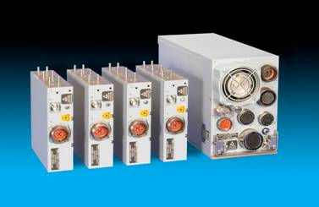
ALR-69A Digital Radar Warning Receiver
Requirement
Current Requirements:
88 ANG/AFRC C-130H 2/2.5/3 – 1067 signed 4QFY15
Requirements on the horizon:
100 ANG/AFRC F-16 Blks 30/42—3QFY16
Active duty C-17s & F-16s
RR
CSP
Background Info
Replaces 1970’s Radar Warning Receivers (RWR) larger footprint with next generation wideband digital channelized receiver technology
Fielded in FY13 on 24 C-130H1
Schedule
Acquisition Planning Start Aug 15
RFI Sep 15
Industry Day Apr 16
RFP Jun 16
Award Jul 17
Fielding TBD

Slide 18
Summary
Anticipate steady stream of business opportunities from Agile Combat Support portfolio
Streamlining the contracting timeline can only occur through disciplined acquisition planning and pre-award execution
Increased transparency and communication is beneficial to Industry and the Government

