Slide 1
Battle Management Program Executive Officer (PEO) Review and Outlook (R&O)
Steve Wert
AFPEO for Battle Management
66ABG/PA Clearance Number: 66 ABG-2016-0034
Distribution A: Approved for public release: Distribution Unlimited.
Date: 24 Mar 2016

Slide 2
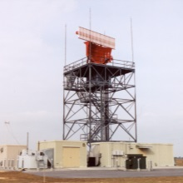
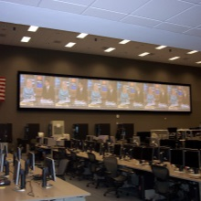
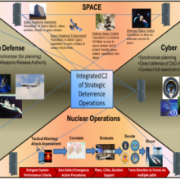
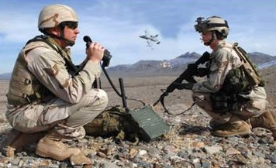
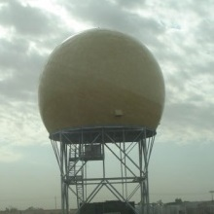
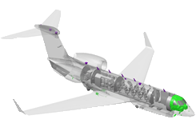
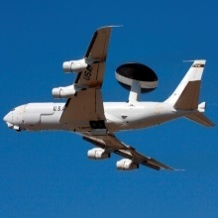
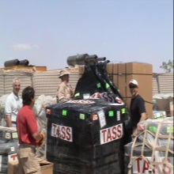
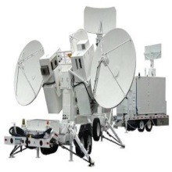
Battle Management Scope and Mission Areas
Vision: The most proactive and effective DoD life cycle management organization
Mission: In partnership with industry, deliver and support warfighting systems—and learn to do better every day
Portfolio: 130+ US programs, ~$12.3B (AY+FYDP)
1 JUON/QRC (IPEC)
7 ACAT I
4 ACAT II
48 ACAT III
12 Tech Project/Other
59 Sustainment
~120 FMS Case/Lines, ~$9.1B
42 nations and NATO
197 Supplies & Services Contracts
Org/People: ~3,500 people
12 Divisions / 9 Major locations
Aerospace Mgnt
Systems
Ops Command
& Control
COCOM Comm
& Control
Theater Battle
Control
C2ISR
Airspace Mission Plan Sys
Foreign Military
Sales
Strategic Warn & Surv Systems
Joint STARS
Recapitalization
AWACS
Force Protection
Aerospace Dominance Enabler
The AF’s core operational C2 systems, battle management, and more
2
2

Slide 3
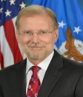
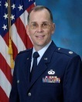
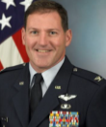
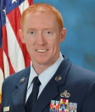
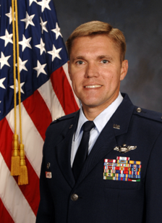
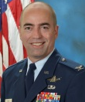
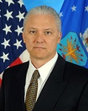
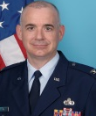
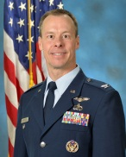
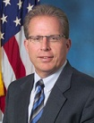
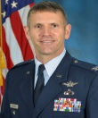
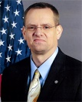
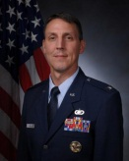
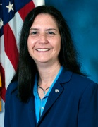
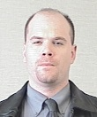
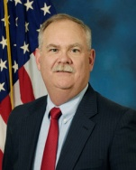
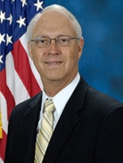
HB Organization
SAF/AQ
MS. DARLENE COSTELLO
(ACTING)
AFLCMC COMMANDER
LT GEN JOHN THOMPSON
AFPEO/BM
MR. STEVEN WERT
SENIOR
INDIVIDUALIZED MOBILITY AUGMENTEE
COL MICHAEL AMIRAULT
DEPUTY DIRECTOR
COL DALE VANDUSEN
SENIOR ENLISTED
ADVISOR
(ACTING)
SMSGT WESLEY KEVILLE
AEROSPACE MGT SYSTEMS DIVISION (HBA)
COL NORMAN LEONARD
OPERATIONS C2
DIVISION
(HBB) COL DON HILL
COCOM C2
DIVISION
(HBC) MR. STACY FURCINI
OFFUTT
THEATER BATTLE CONTROL DIVISION
(HBD)
COL MICHAEL HARM
C2ISR
DIVISION
(HBG) COL RAYMOND WIER III
AIRSPACE MISSION PLANNING DIVISION
(HBM) COL ANDREW KNOEDLER
FMS
DIVISION
(HBN)
MR. STEVE BESSETTE
STRATEGIC WARNING
& SURVEILLANCE
SYS DIVISION (HBQ)
COL TODD WIEST
ROBINS
PETERSON
JSTARS RECAP DIVISION (HBR) COL DAVID LEARNED
AWACS
DIVISION
(HBS)
MR. THOMAS RAMSEY
FORCE PROTECTION
DIVISION (HBU)
MR. PATRICK DAGLE
AEROSPACE
DOMINANCE ENABLER
DIVISION (HBZ) COL MICHAEL HOLL
TINKER
HILL
EN
MR. STEPHEN
FALCONE
FM
MS. BARBARA
BRIAND
HR
MR. ANTHONY DUGGAN
IP
MR JEFF JEGHERS
LG
MR. CHRIS
MC WILLIAMS
PK
MR. PAUL
COMMEAU
PM
MR. DAVID
TEMPLE

Slide 4
AFPEO/BM Top Issues
JSTARS Recap Radar Risk Reduction ADM
AOC 10.2 MAIS critical change
SM-9 contractor performance
3DELRR source selection
E-8C service life and AA
Qatar IAMD executive agent & SAPM
BMEWS/PP/UEWR requirements/test
AOC LTM&S RFP release
Taiwan SRP FoS Ao requirements
Cobra Dane & PARCS supportability
309th performance on TBMCS FL, PRC2, BCS-F, MPS
MAFPS fix plan prior to AMC A&SR
AF-DCGS MAC ID/IQ strategy and OTA

Slide 5
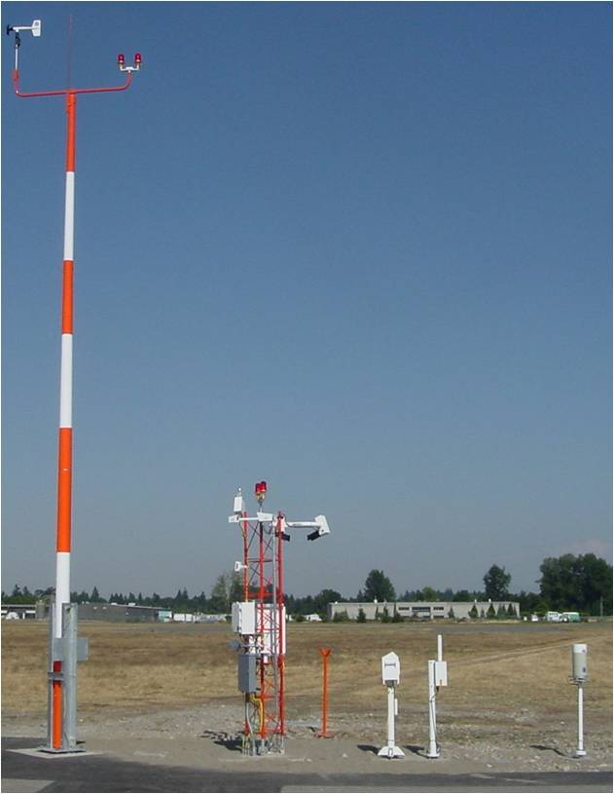
BM Potential Opportunity FMQ-19 Automatic Meteorological Station (AMS)
Small Business Opportunity
Contractor Logistics Support for over 100 fixed automated meteorological stations.
System consists of modular / scalable sensors, which measure surface pressure, wind speed/direction, temp. dew point, relative humidity, liquid precipitation, accumulation & identification, ice accretion, cloud heights, vertical visibility, surface visibility, present weather, precipitation, and lightning detection
Schedule
Contract Information
Industry Day: 16 March 2016
Draft RFP Releases: Sep 2016 / Dec 2016
RFP Release: February 2017
Contract Award: August 2017
Period of Performance: Sep 2017 – Sep 2022
Anticipated Contract Strategy:
~$25M contract value
Small Business Set Aside (TBD)
Anticipated Contract Type:
FFP with cost reimbursable CLINs
POC: Lt BJ Stratemeyer, (781) 225-5386

Slide 6
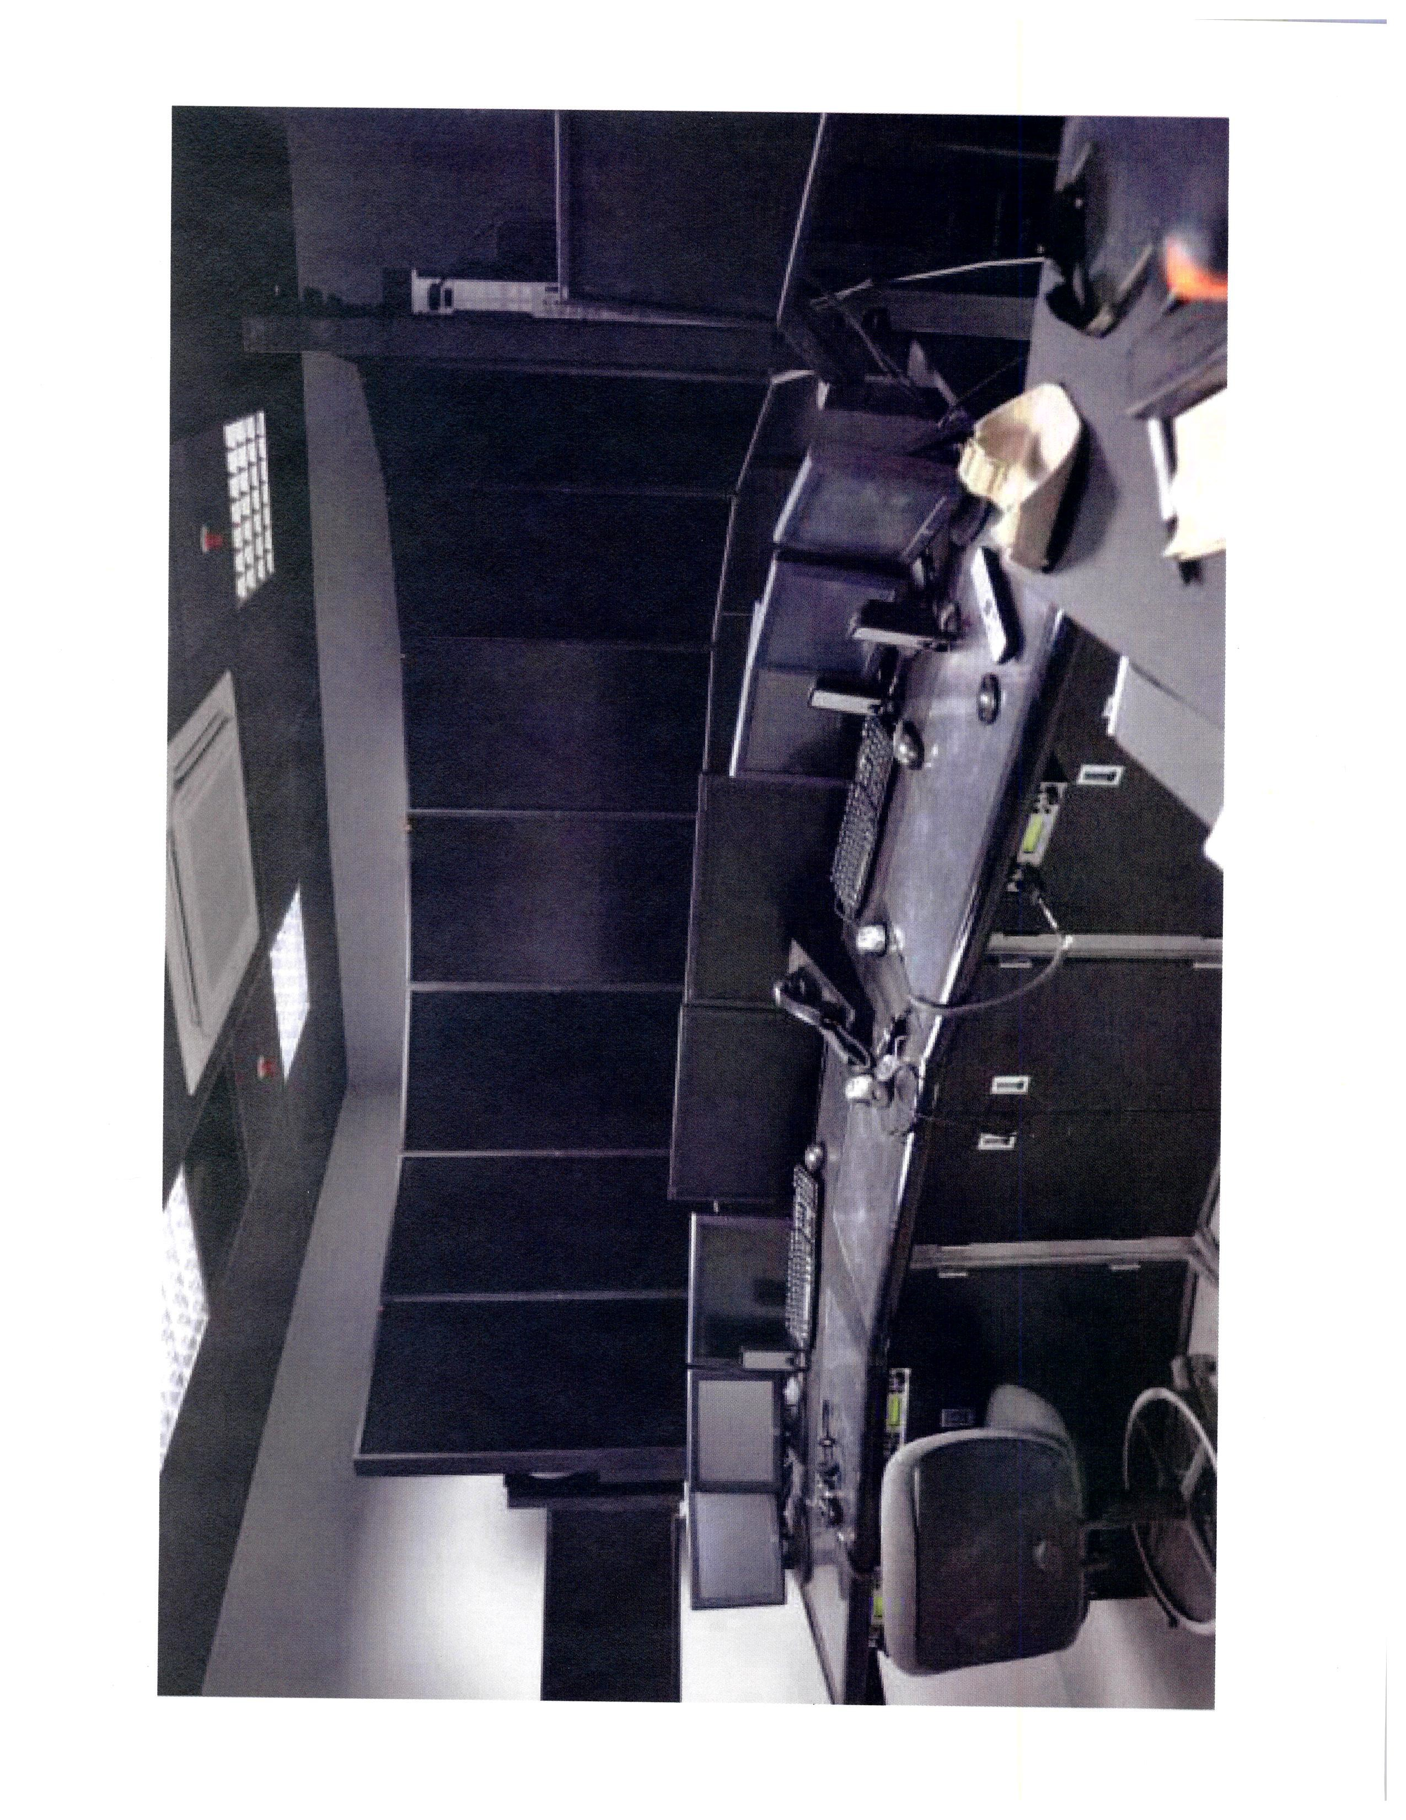
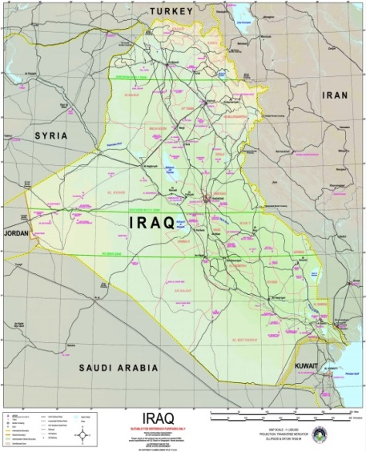
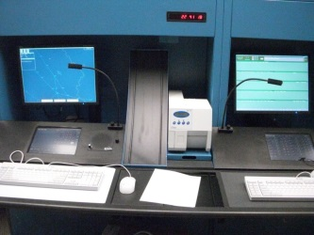
BM Potential Opportunity
Air Traffic Control Tower (ATCT) Equipment and Training Simulator Systems (TSS) Sustainment Program for the Republic of Iraq
Business Opportunity
Conduct site survey
Air Traffic Control Tower (ATCT) equipment at three locations in Iraq
Adacel MaxSim Tower Simulator System (TSS) and Raytheon Company AutoTrak II (AT2) Radar Simulator System (RSS)
Repair damaged items and procure/install replacement parts based on site survey
Provide 1 year of Contractor Logistic Support and a 2 year warranty on all new equipment
Tentative Schedule
Contract Information
Virtual Industry Day: Jul 15
Draft RFP Release: Jan 16
RFP Release: Apr 16
Contract Award: Oct 16
Period of Performance: Oct 16 – Aug 18
Anticipated Contract Strategy:
~$10–$20 Million contract value
Full & Open Competition
Anticipated Contract Type:
Firm Fixed Price
Cost Plus Fixed Fee for replacement items
POC: Mr. Peter Foster, (781)-225-5383

Slide 7
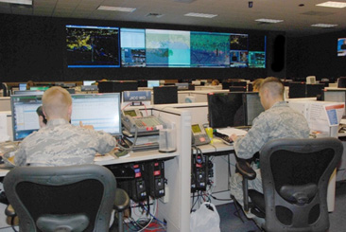
BM Potential Opportunity Air Operations Center Weapon System (AOC WS) Long Term Modification and Sustainment Contract
Business Opportunity
Procure professional services to field, sustain, and modify the AOC WS
Procure the fielding COTS material (hardware, software) and subsequent support agreements
Conduct Capital Equipment Replacement
Schedule
Contract Information
Draft RFP Release: Dec 15
RFP Release: March 16
Contract Award: 1QFY17
Period of Performance: 4 month base plus 7 one year options.
Anticipated Contract Strategy:
~$601-$668M
GSA Alliant contract
Anticipated Contract Type:
CPFF Term LOE
POC: Lt Col Reybitz, (781) 225-9116

Slide 8
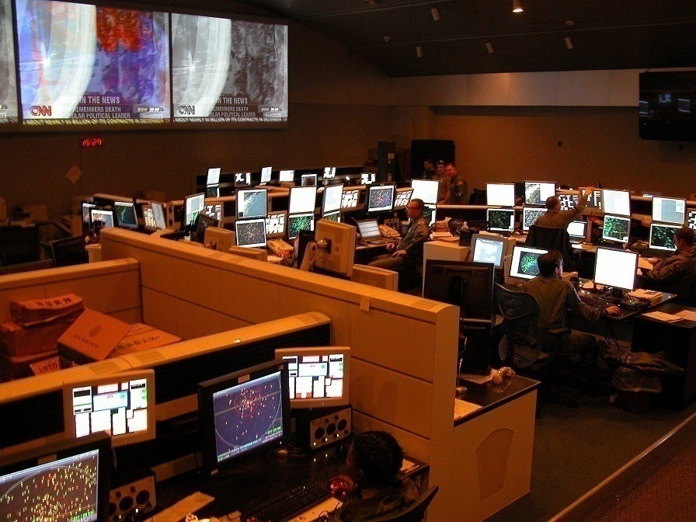
BM Potential Opportunity Battle Control System – Fixed (BCS-F) Contract Logistics Support (CLS)
Business Opportunity
Contract Logistics Support (CLS) and HW/SW Tech Refresh to include System Integration, Technical Orders, Training Materials and able to conduct Depot Level Repairs (DLR), Material Management (MM) and Spares Storage.
Schedule
Contract Information
Anticipated Contract Strategy:
~$48M total contract value
Full & Open Competition
Anticipated Contract Type:
CPFF
POC: Capt James Curran (781) 225-0380
Draft RFP Release: Apr 16
RFP Release: Jun 16
Contract Award: Dec 16
Period of Performance: Jan 17 – Jan 22

Slide 9
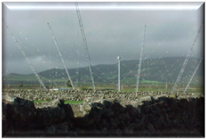
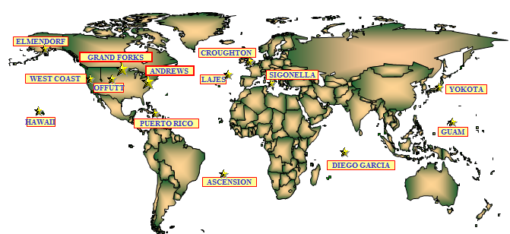
BM Potential Opportunity High Frequency Global Communications Systems Antenna Program IDIQ
Small Business Opportunity
Continue to sustain HFGCS antennas and subsystems
Antenna Repair/Replacement Activity
Tech order support, antenna acquisition & sustainment
Transmission system cabling replacement
Grounding systems repair/replacement
Contractor depot-level maintenance
Support systems and subsystem COTS items
Schedule
Contract Information
Draft RFP Release: Jan 16
RFP Release: Mar 16
Contract Award: Sep 16
Period of Performance: Up to 7 Years
Base Year + 6 Option Years
6-month extension of services
Anticipated Contract Strategy:
~$74.5M contract value
Small Business Set Aside
Competitive
Anticipated Contract Type:
Performance Based Contract
POC: Ms. Kristen Carter, (405) 622-7267

Slide 10
BM Potential Opportunity DGS-X Sustainment
Business Opportunity
Sustainment of DGS-X (Distributed Ground System – Experimental), an operationally representative test facility that evaluates software/hardware upgrades and other capabilities in a controlled environment.
Schedule
Contract Information
RFP Release: 31 Mar 2016
Contract Award: 30 Jun 2016
Period of Performance: 1 Jul 2016 – 30 Jun 2021
Anticipated Contract Strategy:
~$22M contract value
GSA Alliant contract
Anticipated Contract Type:
FFP/CR/LH
POC: Maj Melanie Shepperd, 757-225-0026

Slide 11
BM Potential Opportunity C2ISR Enterprise Contracted Logistics Support
Small Business Opportunity
Procure logistics support services for the C2ISR enterprise with performance requirements in all 12 Integrated Product Support categories
Schedule
Contract Information
Sources Sought: Dec 2015
RFP Release: Dec 2016
Contract Award: April 2017
Period of Performance: May 2017 – April 2022 (1 yr Basic; 4 – 1 yr Options)
Anticipated Contract Strategy:
~$2.0M contract value
Small Business Set Aside
Competitive
Anticipated Contract Type:
FFP – PPTO
POC: Mr. Joseph Eckersley, (478) 222-0945

Slide 12
BM Potential Opportunity Airspace Mission Planning
Business Opportunity
Systems Enterprise Integration Contract (SEIC)
Continue the mission planning environment with the latest software testing and integration advancements.
Support Mission Planning developers
Schedule
Contract Information
RFP Release: May 16
Contract Award: Jan 17
Base Period of Performance: 10 years
MP Knowledge SIL: Available Now!
Anticipated Contract Strategy:
Full and Open
Anticipated Contract Type:
Multiple/Hybrid with Incentives for RDT&E
(CPFF w/ incentives, Cost)
POC: Capt Devon Messecar, (781) 225-9111

Slide 13
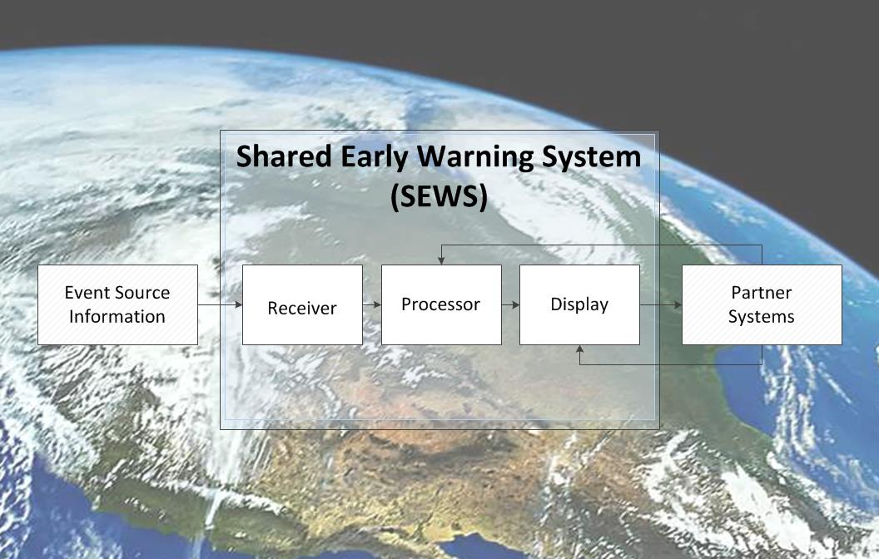
BM Potential Opportunity Shared Early Warning System (SEWS)
Small Business Opportunity
Contractor Logistics Support providing wide range of services such as sustainment, migration, integration, training, help desk support, testing and operational support
Supports existing system sustainment and integration of new mission capabilities and external system integration to U.S. and FMS funded activities
Mission: Provide continuous, near-real-time, early warning information of ballistic missile launches, regardless of predicted impact area, that is of the same high quality and timeliness as made available to U.S. Forces. -- Ballistic Missile Shared Early Warning Policy (7 Sep 07)
Schedule
Contract Information
Industry Day: Oct 15; 17 Feb 16
Draft RFP Release: Feb 16
RFP Release: May 16
Contract Award: Apr 17
Transition: May - Jul 17
Period of Performance: Apr 17 – Sep 22
Anticipated Contract Strategy:
~$93M contract ceiling value
Small Business Set Aside
Single Award IDIQ
Anticipated Contract Type:
CPIF, CPFF and T&M
POC: Ms. Natalia Buchanan, (719) 554-9522

Slide 14
BM Potential Opportunity Joint Surveillance Target Attack Radar System
(JSTARS) Recapitalization
Business Opportunity
Recapitalize legacy E-8C fleet by delivering an integrated weapon system solution comprised of BMC2, radar and communications subsystems on a business class commercial derivative jet
Anticipate releasing an RFP 4QFY16 for a full and open competition. This contract action will include EMD (3 a/c), LRIP (2 a/c), FRP Lot 1 (4 a/c) and ICS
Schedule
Contract Information
Draft RFP Release:
21 Jan 16 (SOW / CDRLs)
Apr 16 (entire RFP includes section L&M)
RFP Release: Sep 16
Contract Award: Dec 18
Anticipated Contract Strategy:
~$7B
Full / Open Competition
Anticipated Contract Type:
CPIF, FPIF, CPFF, FFP, CR
POC: Col Dave Learned – (781) 225-5283

Slide 15
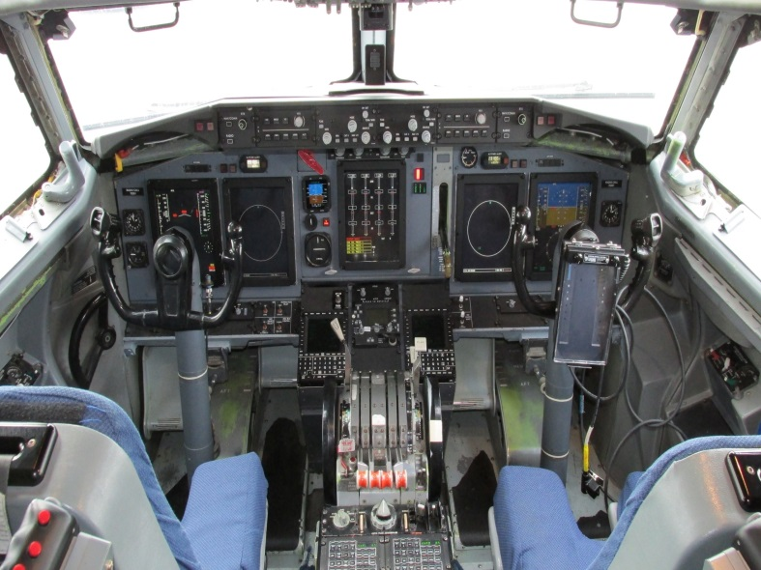
BM Potential Opportunity DRAGON Production Warehousing
Potential Small Business Opportunity
Production (LRIP & FRP)-Warehousing support
Receive/store/manage all DRAGON parts
Deliver required parts to Gov install team
ID/store/use/dispose of HAZMAT
Life limit management items inspected, tested and recertified or disposed of at required intervals
Schedule
Contract Information
Release Request for Information Feb 2016
RFP Release: 4QFY16
Contract Award: 3QFY17
Period of Performance: 2017 - 2026
Anticipated Contract Strategy:
$25M-$40M estimated contract value
Full & Open Competition
Anticipated Contract Type:
FFP
POC: Mr. Steve Clark, GS-13 (781)225-4883
Notes:
Picture Source: E-3 AWACS Program Office, Hanscom AFB, MA

Slide 16
BM Potential Opportunity Mission Planning Support Contract
Small Business Opportunity
Sustainment of Mission Planning Systems (MPS) equipment; includes:
Configuration Management of h/w and s/w
Updates to Technical Documentation
System Checkout, Fielding, & Supply Support
Training Support
Deficiency Reporting
Deployment and Management of the MPS System Support Representatives (SSRs) at worldwide locations and 24/7 Help Desk Support
Administration of Mission Planning Central Website
Schedule
Contract Information
Industry Day: 8-9 Dec 2015
Draft RFP Release: Apr 2016
RFP Release: July 2016
Contract Award: August 2017
Period of Performance: 1 Sep 2017- 31 August 2022
Anticipated Contract Strategy:
~$250M contract value
Small Business Set Aside
Single Award IDIQ
Anticipated Contract Type:
FFP
POC: Christi McElheny, (801) 777-2805

Slide 17
Summary
AFLCMC/HB represents the largest AFMC PEO portfolio
Many business opportunities--if you're qualified, we want to work with you
More sophisticated acquisition strategies--open/layered modular architectures
Reference architectures for new development now common (JSTARS Recap)
Learning how to move closed legacy systems to open (OA DCGS)
Enabling AF to own the technical baseline (ISPAN)
Increasing number and frequency of competitive contract actions and MAC ID/IQs
Increasing small business participation every year from FY11 to today
2012: C2AD contract--5 large and 1 small business
2016: PEITTS contract--5 small and 1 large business

