Slide 1
Program Executive Officer (PEO) Review and Outlook (R&O)
Brian Rutledge
Deputy PEO Fighter/Bomber
24 March 2016
“PA Approved Message Release for Briefing”

Slide 2
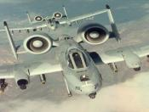
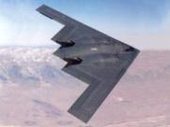
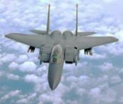
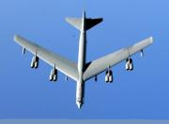
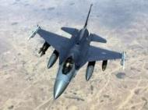
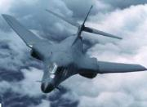
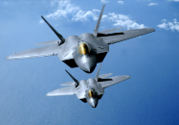
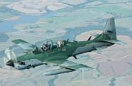
Fighter/Bomber Portfolio
VISION: Warfighter’s choice for life cycle management of war-winning Fighters/Bombers capabilities delivered early and under budget
A-10
B-2
MISSION: Develop, produce, deliver, modernize, and support US and coalition partner fighter and bomber aircraft weapon systems and subsystems
F-15
B-52
156 Programs
2 MDAP, 2 Pre-MDAP (ACAT I)
65 Acquisition Master List (ACAT I, II, III)
89 FMS
6 Geographic Locations:
Hill AFB Tinker AFB
Robins AFB Wright-Patterson AFB
Ft Worth, TX Whiteman AFB
~3000 Authorized Personnel
Military (11%)
Civilian (73%)
A&AS (16%)
~$62B in Active Year Dollars
$9B USAF
$53B FMS
F-16
B-1
F-22
LAS

Slide 3
Organizational Leadership
Fighters/Bombers Directorate & PEO
Air Force Life Cycle Management Center (AFLCMC/WW)
Brig Gen Eric Fick, Director/PEO (WPAFB)
Mr. Brian Rutledge, Deputy PEO/Deputy Director
Col James Gray, Senior IMA
Directorate Senior Functionals (WPAFB)
Mr. Doug Atkinson, Director of Engineering Mr. Gregory Leingang, Chief of Finance Mr. Dennis Lovejoy, Chief of Contracting
AFLCMC/WWE AFLCMC/WWF AFLCMC/WWK
Mr. Lansen Conley, Chief of Logistics Ms. Deborah Webb, Chief of Mgt Ops Mr. Kevin Sherrick, Chief of Security
AFLCMC/WWL AFLCMC/WWO AFLCMC/WWOS
A-10 Division (AFLCMC/WWA)
Col James Flattery, SPM & Chief (HAFB)
Mr. Dan Ipson, Deputy Chief (HAFB)
Ms. Susan Manzanares, PSM (HAFB)
SPM Hill, UT, No GSU
F-15 Division (AFLCMC/WWQ)
Col Timothy Bailey, SPM & Chief (RAFB)
Mr. Bob Zwitch, Deputy Chief (RAFB)
Mr. Eric Wietstruk, PSM (RAFB)
SPM, Robins, GA, WPAFB and SAUDI GSUs
F-35 Division (AFLCMC/WWJ)
Lt Col Matt Herder, Chief (WPAFB)
Mr. Michael Karraker, Deputy Chief (WPAFB)
Mr. William Clark, Chief of Log (WPAFB)
B-1& B-52 Division (AFLCMC/WWN)
Col Timothy Dickenson SPM & Chief (TAFB)
Vacant, Deputy Chief (TAFB)
Vacant, PSM (TAFB)
SPM Tinker, OK , No GSU
F-16 Division (AFLCMC/WWM)
Col Chris Baird, SPM & Chief (HAFB)
Mr. Gregory Brown, Deputy Chief (HAFB)
Mr. Gregory Brown, PSM (HAFB)
SPM Hill, UT WPAFB GSU
F-15 Saudi FMS (AFLCMC/WWQ)
Col Brady Hauboldt, SAPM (RAFB)
Lt Col James Becker, Deputy SAPM (WPAFB)
Lt Col Sean Rivera, Deputy SAPM (RAFB)
Mr. Stephen Niemantsverdriet, Deputy SAPM (RAFB)
B-2 Division (AFLCMC/WWZ)
Col Robert Strasser, SPM & Chief (WPAFB)
Mr. David Garofoli, Deputy Chief (WPAFB)
Ms. Lisa Carney, PSM (WPAFB)
SPM WPAFB, Tinker, OK GSU
Special Programs Division (AFLCMC/WWG)
Col George Griffiths, SPM & Chief (WPAFB)
Ms Stephanie Edquid, Deputy Chief (WPAFB)
Mr. Gary Pritchard, PSM (WPAFB)
SPM WPAFB, Tinker, OK
Directorate Support Staff (WPAFB)
Maj Sunil Nair, Executive Officer
Ms. Cindy Castillo, Executive Assistant
Lt Col Tony Paulson, Chief, PEG/DAG, AFLCMC/WWX
Development and Integration Division (AFLCMC/WWB)
Col Anthony Thomas, Chief (WPAFB)
Mr. Steve Topper, Deputy Chief (WPAFB)
Mr. Terry Caughvenbaugh, PSM (WPAFB)
WPAFB
F-22 Division (AFLCMC/WWU)
Col Anthony Genatempo, SPM & Chief (WPAFB)
Mr. Ed Stanhouse, Deputy Chief (WPAFB)
Ms. Robin Mosely, PSM (WPAFB)
SPM WPAFB, Hill, UT, Langley, VA, Ft Worth, TX GSUs
Strategic Systems Division (AFLCMC/WWS)
Mr. Stephen Uyehata SPM & Chief (WPAFB)
Lt Col Jeffrey Kuhn, (WPAFB)
Mr. Gerald Williams, PSM (WPAFB)
WPAFB

Slide 4
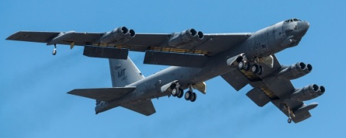
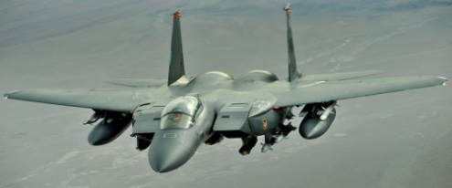
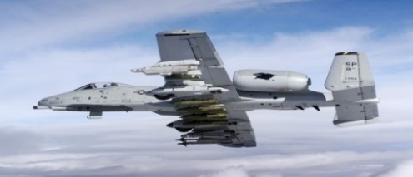
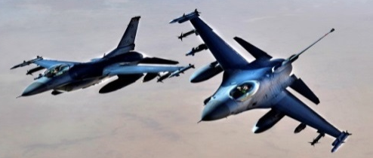
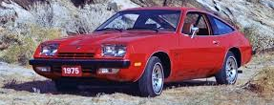
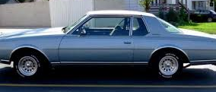
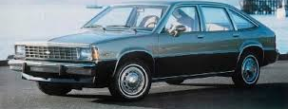
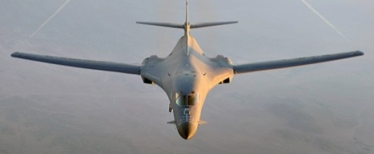
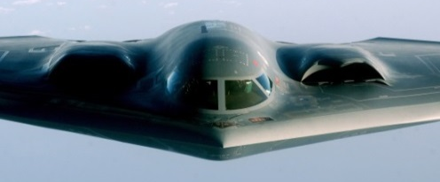
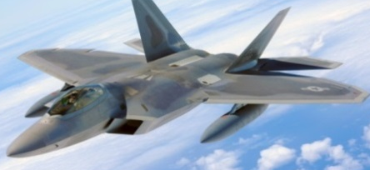
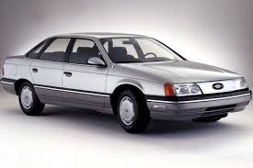
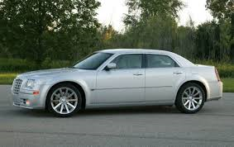
Maintaining an Aging Fleet
IOC & Motor Trend Car of the Year
1952
1975
1977
1980
1986
1997
2005

Slide 5
Fighter/Bomber Portfolio
Average Age Fighter/Bomber Aircraft = 24.4 yrs.
Portfolio funding distribution
Active Year Dollars
Sustainment | $ 3.3B
Production | $ 2.8B
R&D | $ 2.9B

Slide 6
PEO Priorities
Maintaining an aging fleet to meet projected operations
Upgrades
SLEP
PDM inputs
Acquisition flexibility
Timeline of contract awards
Quantity bands
Design agility -- OMS
Identifying C/S/P issues early
Contractor and USG capability and capacity
Prioritizing and managing within limited funding

Slide 7
Acquisition Forecast/Opportunities
Opportunities | Anticipated Value | Period of Performance | Prime or Competitive
F-15 Aircraft Strucutural Integrity Program (ASIP) | $25M | Jul 16 to Jul 19 | Boeing
F-15 Full Scale Fatigue Test (FSFT) | $236M | May 16 to May 21 | Boeing
F-15 OEM Infrastructure (5 year follow-on) | $30M | Mar 17- Feb 22 | Boeing
F-15 Depot Overhaul Manuals | $3M | Jul 16 to Jul 18 | Competitive
F-15 Engineering & Technical Analysis | $7M | Nov 16 to Nov 21 | Competitive
F-15 Silver Bullets (Follow on) | $20M | May 18 to Apr 23 | Boeing
F-15 Kadena AB F-15 PDM | $65M | Sep 16 to Sep 17 | Korean Airlines
F-15 Kadena AB F-15 PDM Follow-on | $424M | Sep 17 to Sep 23 | Competitive

Slide 8
Summary
Platforms are not getting younger – staying in the fight
Integrated sustainment strategies
Acquisition flexibility required from all parties
Contracting
Design flexibility
Building flexible capability and capacity
Integrated Sustainment Strategies Required to Affordably Sustain Aging Fighter/Bomber Fleet

