Slide 1
Program Executive Officer (PEO) Review and Outlook (R&O)
KEVIN W. BUCKLEY, SES
PEO for Mobility
24 March 2016
“PA Approved Message Release for Briefing”

Slide 2
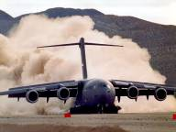
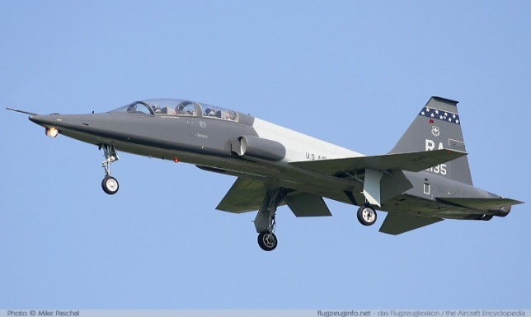
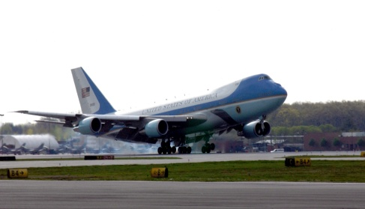
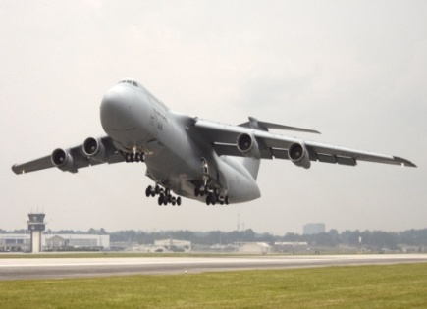
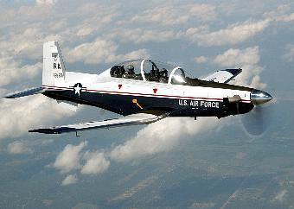
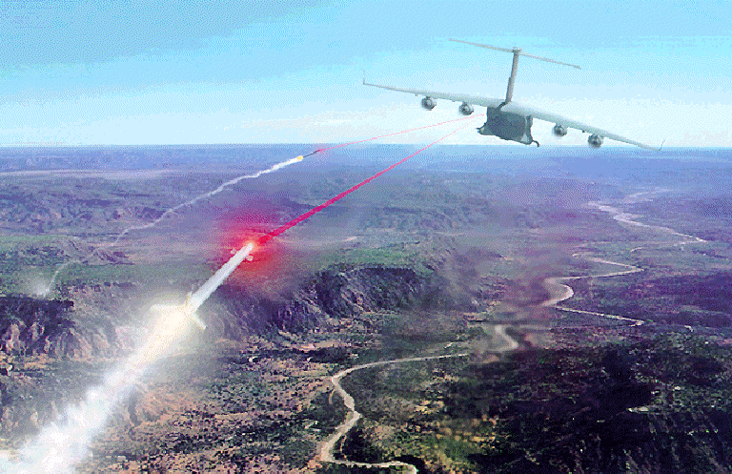
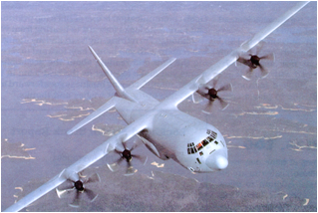
PEO MOBILITY
MISSION: Manages development, production, test, deployment, and sustainment of a mobility and training aircraft portfolio to meet Air Mobility Command, Air Education and Training Command and Air Combat Command mission area requirements.
Major Weapon Systems and Programs:
ACAT I: C-130J, HC/MC-130 Recap, C-5 RERP, JPATS, T-X, PAR
ACAT II: C-17 (4 programs), C-130 CWB, C-130J Blk 8.1 Retrofit
ACAT III: C-5 LAIRCM, C-5 ACARS, C-5 CMC/Wx Radar, HC-130H RDS, C-130J LAIRCM, T-38 PCIII, E-4B/LFTS, C-27J, LAIRCM ETA, E-4B LFTS, VC-25 AMP, C-130H AMP Inc 1, C-17 CN&CM, C-32 NGS
194 Programs
67 on Acquisition Master List
127 Foreign Military Sales (FMS) Cases
103 Non-Investment/Service Contracts
1,797 Personnel Authorized (AF and CME)
$28.6B in Active Appropriations
$19.5B in FMS
as of 20 Jan 16
For Official Use Only
Notes:
The AFPEO Mobility is responsible for program execution to develop, acquire, field, and modernize capabilities; and support for life-cycle management of the Mobility and Training aircraft portfolio to address requirements for the Mobility Air Forces and trainers
Currently the Directorate executes 302 programs including 8 ACAT I, 6 ACAT II and 65 ACAT III programs, over 98 Non-investment and Service contracts projects and activities and 125 Foreign Military Sales cases.
The Wing executes these programs using 2292 authorized personnel.
The Wing currently has over 22.2 billion dollars in execution in acquiring these Air Force mobility programs and over 14 billion dollars in execution for acquiring systems and support for Foreign Governments.
PROGRAMS 79 AML Programs
ACAT 1D/C (8) - C-5 RERP, C-130 AMP, C-130J,, C-27J, HC/MC-130 Recap, JPATS, APT, PAR: Inactive MDAPs C-5 AMP LAIRCM
ACAT II – C-17 (6) (Common Configuration, ER/OBIGGS, GRIP, LAIRCM, Comm/Nav & Cap; C-130 CWB
ACAT III (65) –
Non-investment and Service contracts projects and activities (98): Non-investment Programs (45); Service contracts > $100M (15); Service Contracts < $100M (38)
FMS (125) Cases with 14 aircraft types with 44 Countries
ASSIGNED PERSONNEL information is as of 1 Jul 12
Total 1940 without FMS personnel
Military –126 Authorized , Civilian – 1427 Authorized, A&AS – 387 Authorized
FMS Total – WL – 160, TAD – 36, WR – 113, OC – 19, OO – 24
Total 2292 with FMS personnel
FUNDING (Total Funds (FY10/11/12) in Execution) as of 1 Jul 12
USAF Funding ($M)
C130 AMP $25.2 C130 J $2,534 VIPSAM $965.8
LAIRCM $205.2 C-17 $14,400
C5 (Total) $2,835. Trainer $962.8
HC/MC-130 Recap $2,262 MAPA $135.6
JCA $1,202.00
Total AFPEO Mobility $25,527.6 Million
FMS LOA Value ($M) (Without FMS New Business)
C-130 $3.747.91 MAPA $73.87 Training A/C $151.24
LAIRCM $434.00 Special Duty $791.84
C-17 $8,430.00 C-27J $941.00
Total AFLCMC/WL FMS $14,295,000 Million
AS OF: 1 Jul 12

Slide 3
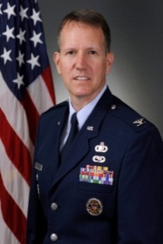
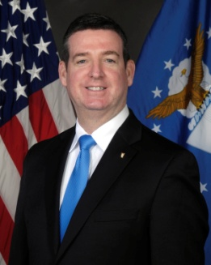
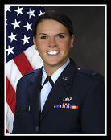
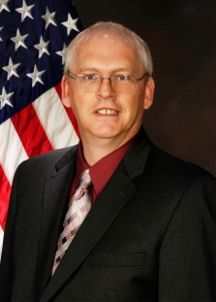
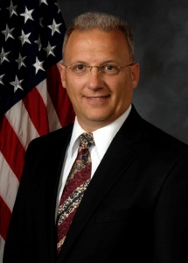
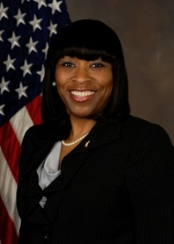
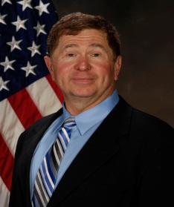
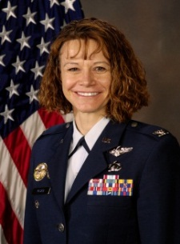
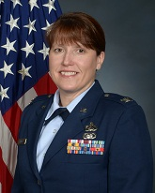
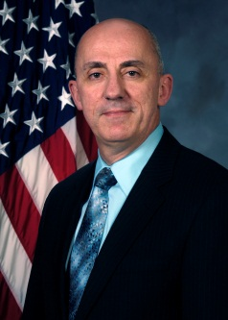
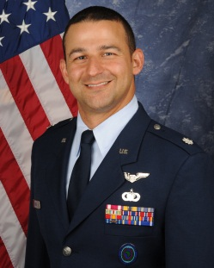
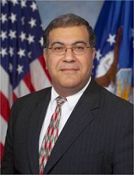
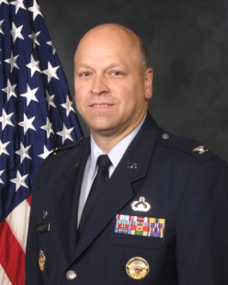
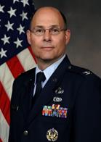
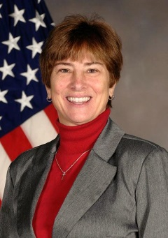
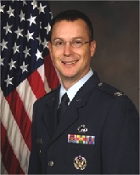
Mobility Leadership
Director and PEO
Mr. Kevin Buckley
Directorate Staff
Deputy Director
Col Robert Mocio
Executive Officer
Lt Rachel Mannix
Division Leads
Engineering (WLE) Mr. Chris Perkins
Financial Mgmt (WLF)
Mr. Todd Green
Contracting (WLK)
Ms. Rosalind Harper
Mature & Proven Aircraft
WLD (Hill AFB)
Ms. Mary Micheal
International Acquisition
WLI (WPAFB)
Mr. Doug Robertson
Direct Support Aircraft
WLJ (WPAFB)
Col Amy McCain
C-17 Globemaster
WLM (Robins AFB)
Col Amanda Myers
Logistics (WLL)
Mr. Daryl Kitchen
Chief Mobility Program Execution (WLX)
Lt Col Gustav Jordt
C-130 Hercules
WLN (Robins AFB)
Mr. Mike Sorial
C-5 Galaxy
WLS (Robins AFB)
Col J Raegan Echols
Commercial Derivative
WLV (AFB) Tinker
Col Robert Dietrick
Aircraft Survivability
WLY (WPAFB)
Ms. Jacque Fisher
Training Aircraft
WLZ (WPAFB)
Col Peter Eide
as of 20 Jan 16
For Official Use Only
Red – Robins AFB Green – Hill AFB Blue – Wright Patterson AFB Yellow – Tinker AFB

Slide 4
PEO Priorities
Improve Ownership of the Technical Baseline
Overcoming the “CLS for Life” Decisions in the ‘90s
Improving Directorate Small Business performance
Promoting effective competition
Notes:
Previously

Slide 5
Acquisition Forecast/Opportunities
Advanced Pilot Training (APT) Family of Systems (FoS)
T-6 Contractor Operated Maintained Base Supply (COMBS III)
Afghanistan Trainer Program CLS
C-130H Avionics Modernization Program (AMP) Increment 1
Notes:
3/11/15 – Slide Updated <jdr>

Slide 6
Advanced Pilot Training (APT) Family of Systems (FoS)
Brief Description: The APT effort will replace the aging T-38 fleet with an adaptable training system. The identified capability gaps that APT fills are sustained High-G maneuvering, night vision goggle operations, in-flight refueling, and advanced sensor management. In addition, APT will enable training downloading and offloading.
The APT effort will drive close collaboration with industry to explore cost-capability value trade-space, transparency, and establish robust solicitation demanding high fidelity data for future sustainment & capability growth
Program Value: ~$49 Billion through FY45
Estimated Current Contract Period of Performance: Lifecycle runs through 2045. EMD (September 2017-December 2022), Production (June 2021)
Full & Open Competition for EMD. Priced options for LRIP and ICS. NTEs options for FRP.
Executing Program Office: Training Aircraft Division, Mobility Directorate, Wright-Patterson AFB, OH
Notes:
3/11/15 – Slide Updated <jdr>
Replaces T-38 fleet
Closes identified APT capability gaps
Sustained High-G maneuvering
Night Vision Goggle Ops
In-flight Refueling
Advanced Sensor Management
Enables training downloading & offloading
Est. Total Prgm Value: $49,075M (Life Cycle, thru FY45)
RDT&E: $1,292M
Procurement: $19,278M
O&S: $28,505M
Est Period of Performance
EMD SEP2017 – DEC2022
Production JUN2021
SEP2029, Life Cycle run thru 2045
Close collaboration with industry to explore cost-capability value trade-space
Transparency with Industry:
‘Bending the Cost Curve’ pilot program
Two (2) Industry days completed focused on requirements feasibility/stability
Future requirements RFIs, pre-solicitation activities & multiple Draft RFP iterations planned into schedule
Promote Effective Competition: Full & Open Competition for EMD, priced options for LRIP, ICS, and NTEs options for FRP
Establish robust solicitation demanding USAF high fidelity data for future sustainment & capability growth
Procure an adaptable training system; plan for growth and change

Slide 7
Contractor Operated Maintained Base Supply (COMBS III)
Brief Description: This effort will provide COMBS services for the T-6A/B Texan II fleet aircraft. COMBS services will include the responsibility to stock, store, issue, repair/overhaul, replace and procure material using FAA standard processes to support the T-6 fleet at eight Main Operating Bases (MOBs) and three Satellites. The contractor will provide services and serviceable material to support safe, flyable aircraft to meet the user’s daily flight schedule.
Program Value: ~$1.98 billion
Estimated Current Contract Period of Performance: 5-8 years (1 year base plus 4-7 one year options)
Full and Open Competition. A Small Business set aside not anticipated.
Executing Program Office: The Training Aircraft Division at WPAFB will conduct the source selection and initial program management. This program will transition to Tinker AFB after contract award for program and contract management.
Notes:
3/11/15 – Slide Updated <jdr>
3/9/16 – slide updated <gjj>

Slide 8
Afghanistan Trainer Program CLS
Brief Description: This effort will transition the C-208 Afghan Trainer program from Interim Contractor Support (ICS) to Contractor Logistics Support through a Competitive Source Selection. The contractor will maintain the C-208B fleet of 24 aircraft, one Aircrew Training Device, and one Maintenance Training Device. Additionally, the contractor will continue to develop a cadre of Afghan Air Force maintainers capable of organically maintaining the fleet of C-208B aircraft
Program Value: ~$203.6 million
Estimated Current Contract Period of Performance: 5 years (3 month Phase-in, 9 month base, Four 1-year options)
Full and Open Competition. A Small Business set aside not anticipated.
Executing Program Office: The Training Aircraft Division at WPAFB will conduct the source selection and program management.

Slide 9
C-130H Avionics Modernization Program (AMP) Increment 1
Brief Description: The C-130H AMP program is a safety and airspace compliance program for 172 combat delivery C-130H fleet and 6 LC-130Hs to meet FAA and European Union mandates. The effort will modify legacy C-130Hs with 8.33 kHz radios, enhanced Mode S, Automatic Dependent Surveillance – Broadcast (ADS-B) Out, and an updated Cockpit Voice Recorder/Digital Flight Data Recorder, while retaining Traffic Collision Avoidance System II
Program Value: $231 million
Estimated Current Contract Period of Performance: FY17–FY20 Source Selection starts April 2016
Full and Open Competitive Small Business Award: March 2017
Executing Program Office: C-130 Hercules Division at Robins AFB will conduct the source selection and program management through Wright-Patterson AFB.

