Slide 1
Program Executive Officer (PEO) Review and Outlook
24 March 2016
Brig Gen Shaun Q. Morris
AFPEO for Weapons
Eglin AFB FL
Distribution A: Approved for public release per 96TW-2016-0051

Slide 2
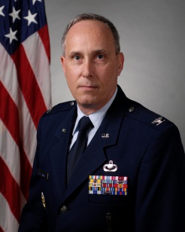
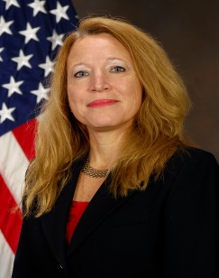
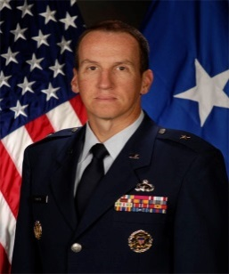
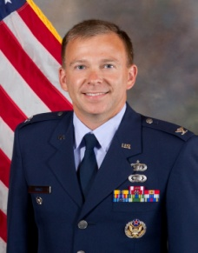
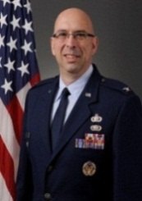
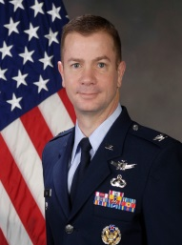
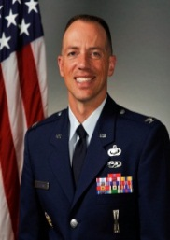
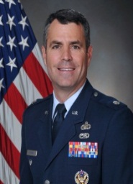
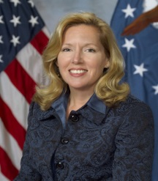
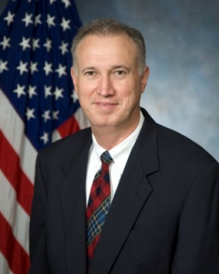
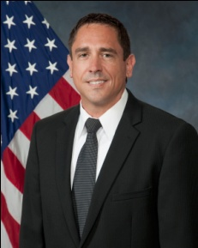
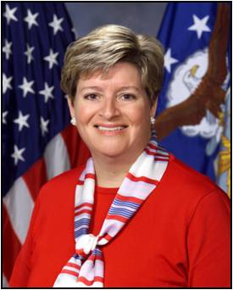
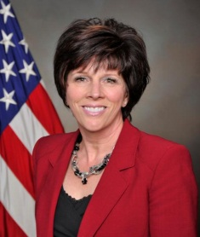
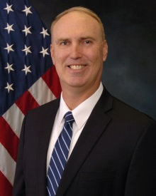
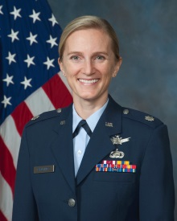
Organizational Leadership
Dr. Yvette S. Weber
Deputy PEO (AF))
Brig Gen Shaun Q. Morris
PEO for Weapons & Director
Mr. John S. Batog
Deputy PEO (USN)
Col J. Sobel
Air Dominance
Col D. Cochran
Direct Attack
Mr. D. Kicklighter
Specialized Mgmt
Col W. Bell
Munitions Sust
Col C. Athearn
Long Range Systems
Col K. Hickman
Miniature Munitions
Mr. M. Stallworth
Armament Sustainment
Ms. B. Thorn
Advanced Programs
Ms. E. Jay
Test & Training
Mr. Bruce Young
Director of Engineering
Mr. Troy Gunter
Chief of Contracting
Ms. Leah Hodge
Chief Financial Officer
Ms. Lynnette Keesler
Chief of Logistics
Mr. George Rogers
Chief of Armament Ops
Lt Col Amy Caruthers
PEG Chief
Notes:
Note: My team responsible for executing this portfolio
(e.g., PEO level focal point(s) for engaging with industry, acquisition locations where portfolio is managed, key PM and contracting focal points at each acquisition location)
Note: might want to limit POC contact info to e-mail addresses rather than providing phone numbers….

Slide 3
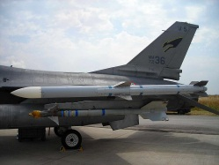
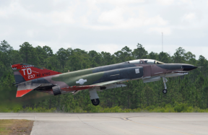
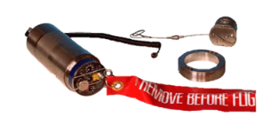
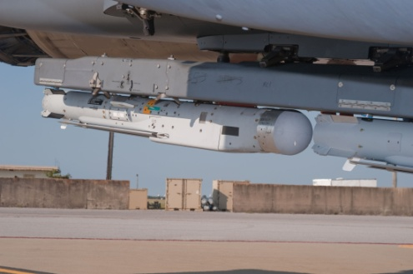
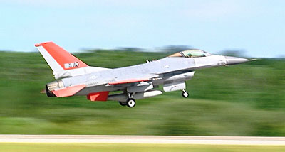
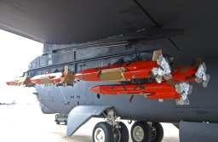
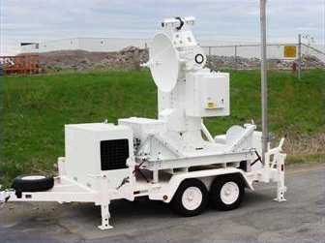
Portfolio Overview
Air Dominance
Direct
Attack
Specialized Management
Armament / Munitions Sustainment
Proven
Aircraft
MOP
BLU-129/B
Med Cal Ammo
LWIP
AMRAAM
AIM-9X (Navy-led)
HTS
HTVSF
JPF
M-Code
ILW
HCSM
QF-4
JDAM
Paveway
Flares
HARM
CAD/PAD
Small Arms
Maverick
Hellfire
Miniature Munitions
Test & Training
Advanced Programs
Long Range Systems
Combat & Mission Support
JASSM
JASSM-ER
P5CTS
ARTS
SDB II
SDB I
MALD
MALD-J
JTE
UMTE
Legacy Threat Systems
JMM BRU
BRU-61/A
TCS
AFSAT
QF-16
CRIIS
Nuclear Deterrence Ops
Space Superiority
Global Precision Attack
Special Operations
Command and Control
Building Partnerships
Education and Training
Air Superiority
Cyberspace Superiority
Rapid Global Mobility
Global Integrated ISR
Personnel Recovery
Agile Combat Support
ACAT I
ACAT II
ACAT III or other

Slide 4
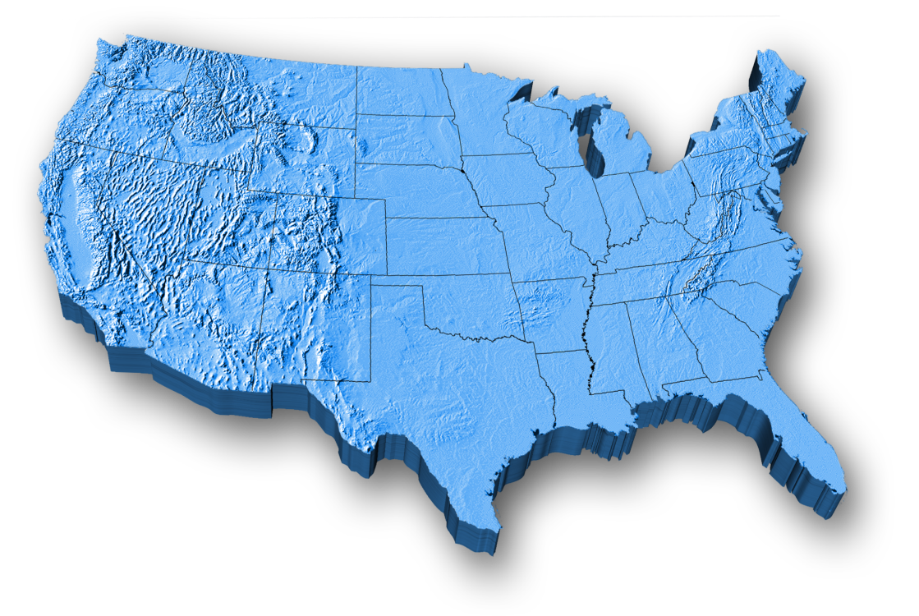
Armament at a Glance
Weapons Portfolio
Hill
Rock Island
Picatinny Arsenal
Crystal City
Indian Head
NAS Pax River
Robins
JB San Antonio
Eglin
$67B Armament Directorate Portfolio
 | Directorate | AFPEO/WP
Total WML | 89 | N/A
Total AML | N/A | 27
ACAT I | 6 | 6
ACAT II | 3 | 3
ACAT III | 14 (including WPS, Navy) | 18 (HBZ, WLD, Navy)
Pre-MDAP | 1 | 1
QRC | 4 | 2
ACAT I – 8
ACAT II – 4
ACAT III – 28
JUON - 1
QRC – 1
Non-ACAT-1
Notes:
These reflect the DIRECTORATE ACAT programs and the PEO AML programs
ACAT I
JASSM Joint Air to Surface Standoff Missile
JASSM-ER JASSM-Extended Range- recent approval. Now officially on the AML
SDB II Small Diameter Bomb II
AMRAAM Advanced Medium Range Air-to-Air Missile
JDAM Joint Direct Attack Munition
HTM Hard Target Munitions (Pre-MDAP) -- XZW (PEO program, not EB program)
AIM-9X*- USN Program (EB program, not PEO program)
B61 (EB program, not PEO program)
ACAT II
MALD-J Miniature Air Launch Decoy-Jammer: NOTE that MALD is not on the AML it was previously removed as it entered sustainment
QF-16 FSAT QF-16 Full Scale Aerial Target
SDB I Small Diameter Bomb I
ACAT III
AMRAAM EPIP AIM-120 Electronic Protection Improvement Program Basic
AMRAAM EPIP AIM-120 Electronic Protection Improvement Program Advanced
MALD-J GAINS II Miniature Air Launched Decoy-Jammer GPS-Aided INS II
AFSAT Air Force Subscale Aerial Target
CEAR Common Electronic Attack Receiver (HBZ)
HCSM HARM Control Section Modification
JPF Joint Programmable Fuze
JTE Joint Threat Emitter (HBZ)
LRTSMLCM Legacy Range Threat Systems Low Cost Modifications (HBZ)
MDS/HTS Manned Destructive Suppression/HARM Targeting System
P5CTS P5 Combat Training System
UUP Unmanned Threat Emitter Upgrade Program (HBZ)
ARTS-V2 Advanced Radar Threat System (HBZ)
BRU-61/A DPM BRU-61 Dual Power Modification
BLU-129/B Carbon Fiber Bomb Body, Very Low Collateral Damage (QRC)
CRIIS Common Range Integrated Instrumentation System (N/A)
HTVSF Hard Target Void Sensing Fuze
ACAT III Proposed AML Additions
WPS Weapons Planning Software
TCS Target Control System
A2K Advanced 2,000lbs Penetrator Demonstration
A5K Advanced 5,000lbs Penetrator Demonstration
SFSS Subminiature Flight Safety System
JMM BRU Joint Miniature Munitions Bomb Rack Unit
AMRAAM SIP AIM-120 System Improvement Program
AMRAAM F3R AIM-120 Form Fit Function Replacement
ILW Improved Lethality Warhead
JUON
MOP Massive Ordnance Penetrator
QRC
Pre-MDAP LRSO Long Range Stand Off (pre-MS A)

Slide 5
PEO Priorities
Resource, Develop, & Care for a Mission-Driven Workforce
Disciplined Program Execution
Should Cost
Increase Competition
Reduce Sole Source Costs (Prices)
Increase Contract Flexibility
Hold Contractors Accountable
Improve Stakeholder Relationships
Integrated Life Cycle Management
Integrated Armament Enterprise

Slide 6
Rapid Innovation Fund (RIF) FY16 Thrust Areas
Denied Area Technologies
Enhance position, navigation, & timing (PNT) accuracies
Extend effective range of weapons
Overcome GPS-contested environments
Target Prosecution
Improve fuzing capabilities/producibility
Enhance target recognition
Enable replacement of cluster munitions
Weapon Performance & Effectiveness
Increase cockpit selectable weapon characteristics
Adjust warhead effects to optimize lethality/control collateral damage
Multiple weapons effects through datalink or net-enabled capability
Weapon Affordability
Low cost materials and low cost navigation and guidance solutions
Addressing UAI compliance and cyber-resilience in early design phase

Slide 7
Acquisition Forecast & Opportunities
Program | Description | Estimated Value | Forecast PoP | Competitive/ Sole Source | Organization
AIM-120 AMRAAM Containers | Procure AMRAAM containers for Tactical and CATM missile production in support of Foreign Military Sales (FMS) | $3-5M | 2018-2023 | Competitive | AFLCMC/EBR
AIM-9P SR-116 Rocket Motor | Two countries procuring 580 each AIM-9P rocket motors to replace expiring rocket motors (FMS only) | $16.2M | 2017-2019 | Competitive | AFLCMC/EBR
BRU-57 with Universal Armament Interface (UAI) | Two countries procuring 186 each BRU-57 with UAI (FMS only) | $54M | 2016-2020 | Sole Source - Exelis (PROS IV) | AFLCMC/EBR
Notes:
Note: Upcoming funded or unfunded opportunities where I need assistance from my Industry partners (both large and small)
(e.g., include program title, brief description, estimated dollar value, forecast period of performance, competitive or sole source (if sole source, ID prime and then encourage interested subcontractors), organization executing acquisition)
Note: should focus on things not yet solicited (i.e., real opportunities rather than things it’s too late for companies to participate in)…remember, this is a forecast.

Slide 8
Questions?
Brig Gen Shaun Q. Morris
AFPEO for Weapons
24 March 2016
Distribution A: Approved for public release per 96TW-2016-0051

